Slide 1
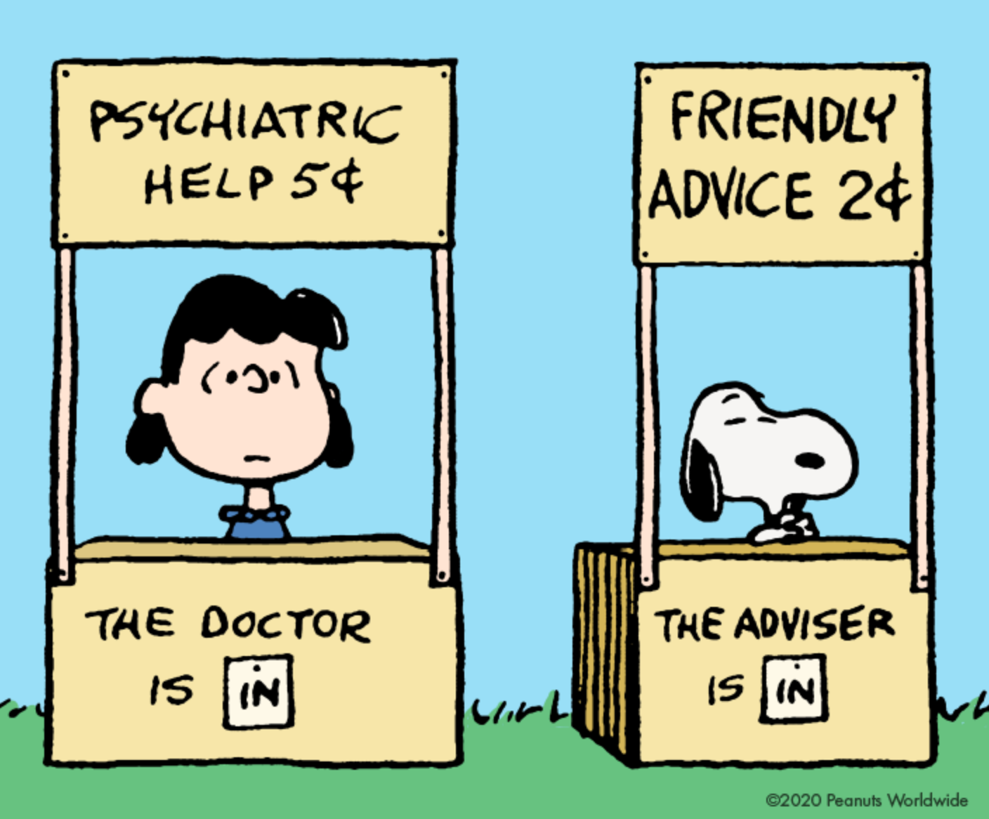
The Dentist is In...
Why Should I bring my Child to a Pediatric Dentist?

Slide 2
American Academy of Pediatric Dentistry Definition of Special Health Care Needs...
...as “any physical, developmental, mental, sensory, behavioral, cognitive, or emotional impairment or limiting condition that requires medical management, health care intervention, and/or use of specialized services or programs.”

Slide 3
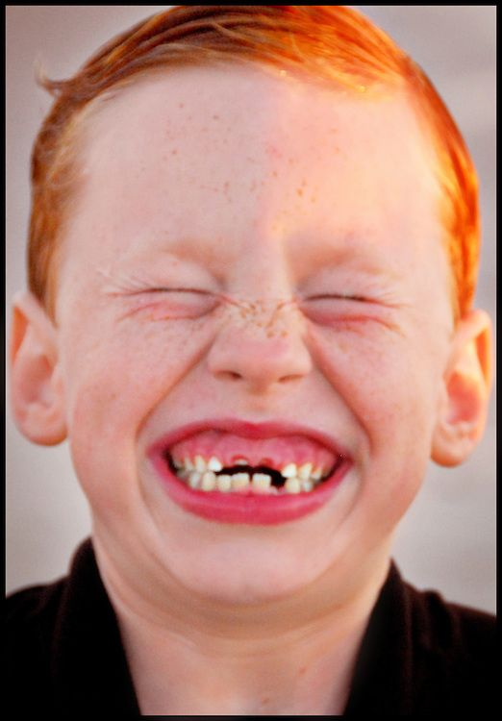
We Serve Patients w/ Special Health Care Needs
Autism
Down Syndrome
Osteogenesis Imperfecta
Cleft Lip/Palate
Cerebral Palsy
Amelogenesis Imperfecta
Cystic Fibrosis
Muscular Dystrophies

Slide 4
Pediatric Dentists have Specialized Training
Increased awareness and attention
Adaptation
Accommodative measures
Those with a dental home are likely to receive appropriate preventive and routine care
Education for modified oral hygiene instruction
Education of diet and nutrition
Help with transitioning to a general dentist once patients reach adulthood
Use of Protective Stabilization techniques for behavior guidance
Sedation or general anesthesia for safe and effective treatment

Slide 5
“Individuals with SHCN may be at an increased risk for oral diseases throughout their lifetime.”
Oral diseases can impact health and quality of life
Lack of preventative and timely therapeutic care can increase the need for costly care and exacerbate systemic health issues
SHCN patients may express a greater level of anxiety about dental care
Impact frequency of dental visits

Slide 6
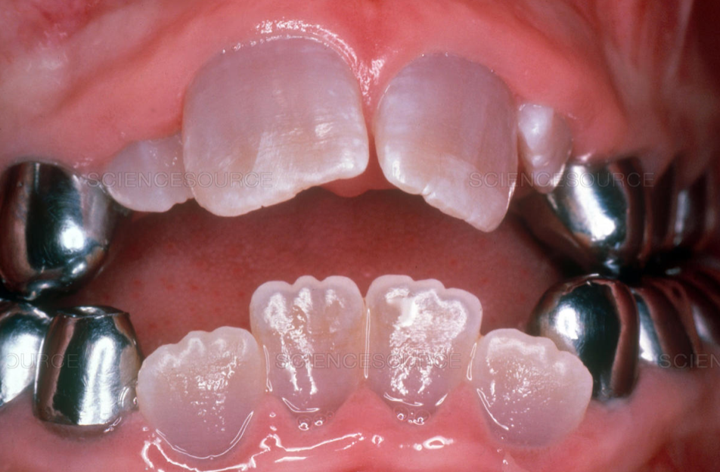
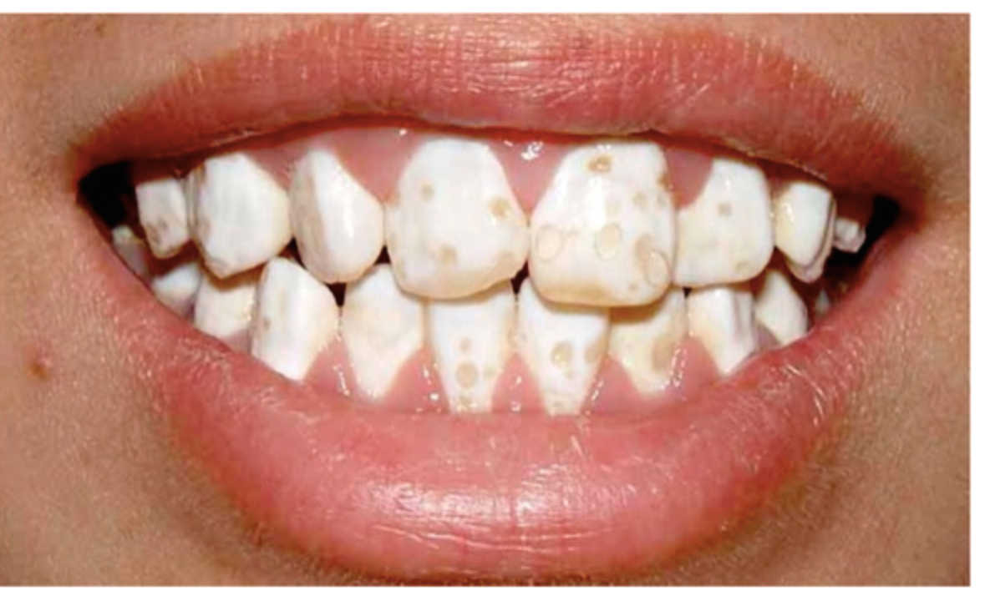
Congenital syndromes can cause teeth to not form properly
Dentinogenesis Imperfecta:
Condition characterized by teeth with a translucent and discolored appearance
Tend to have teeth that are weaker than normal, which leads to wear, breakage, and loss of teeth
Amelogenesis Imperfecta:
Causes teeth to be small, discolored and prone to rapid wear and breakage
Effects the enamel, and can be hypocalcified

Slide 7
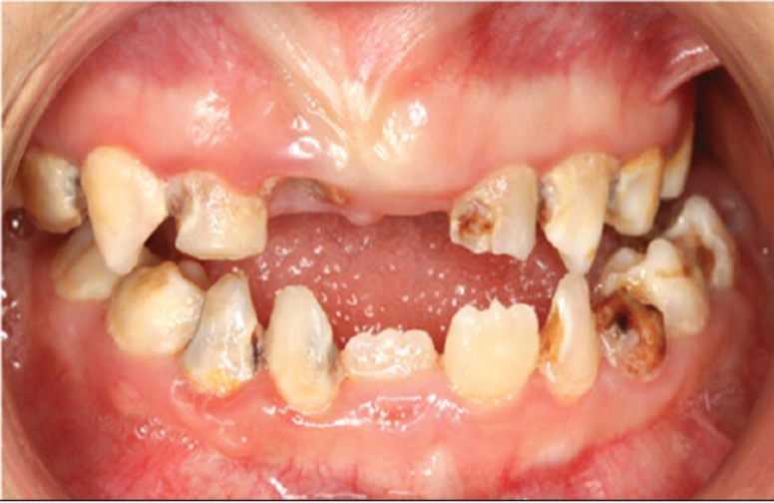
Generally, children with SHCN have increased prevalence of cavities due to:
Uncoordinated chewing may leave food in the mouth
Uncoordinated tongue unable to aid in cleaning teeth
Difficulty with proper tooth brushing
Gagging or dislike of taste/feel of toothbrush, paste, saliva
Diet may include fermentable carbohydrates
Medications may cause xerostomia
If GERD and vomiting is present
Gingival hyperplasia and crowding of teeth are risk factors

Slide 8
All children with Special Health Care Needs will benefit immensely from seeing a dentist
Special considerations are taken
We will discuss some of these considerations for the following:
Autism Spectrum Disorder
Cerebral Palsy
Down Syndrome

Slide 9
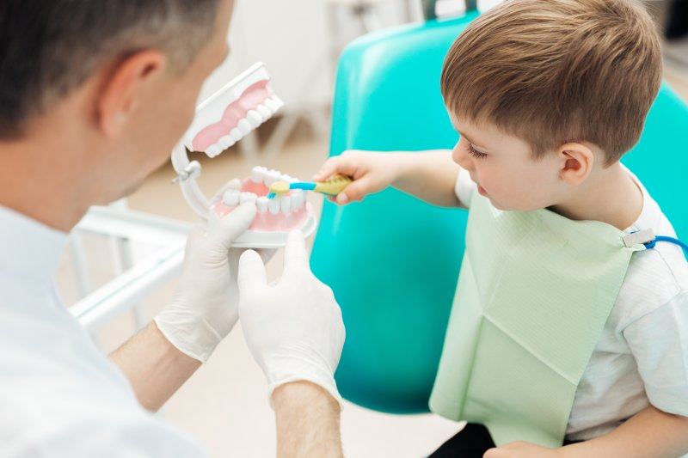
Autism Spectrum Disorder
Oral manifestations
At risk for poor oral hygiene and increased incidence of dental caries
Preparation prior to dental visit
Information of your child’s
Diet
Oral hygiene
Level of cooperation
Oral health needs
Medications
Bringing a comforting item (such as a stuffed animal) may be helpful for your child

Slide 10
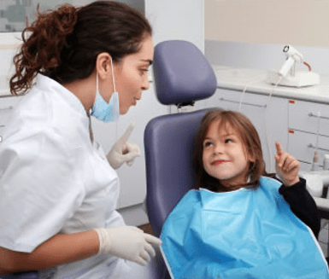
Autism Spectrum Disorder
Expectations during the appointment
Shorter and during quieter times of the day
May need sensitization appointment(s) if possible
Restraints may be needed
If unable to complete treatment, may need oral conscious sedation, Nitrous oxide analgesia, IV/General Anesthesia
After the appointment
Review care plan
Regular oral hygiene help from caregivers important

Slide 11
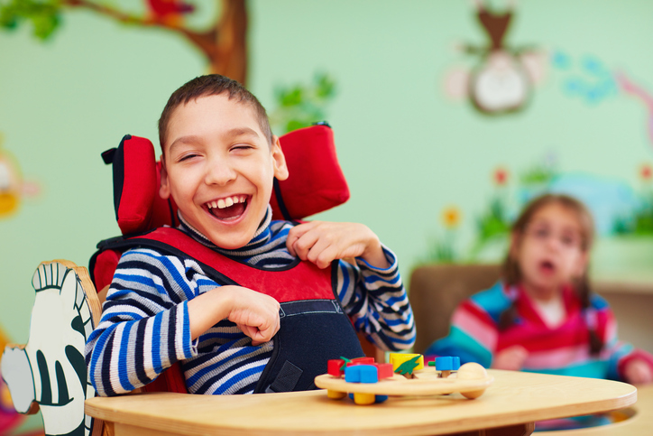
Cerebral Palsy
Oral Manifestations
Gastroesophageal reflux - erosion
Gingival overgrowth if taking certain seizure medications
Maxillary protrusion - may be prone to tooth trauma
Heavy plaque and calculus - periodontal issues
Dental caries may be present
Generalized tooth spacing
Tongue thrusting
Mouth breathing
Perioral sensitivity
Excessive gagging/ severe gag reflex

Slide 12
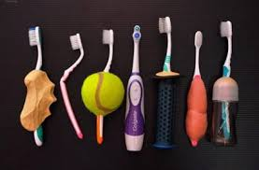
Cerebral Palsy
Preparation prior to dental visit
Medical history
Expectations during the appointment
Morning appointments
May do exam/treatment in wheelchair
Nitrous oxide sedation may reduce involuntary movements
Careful use of restraints to help immobilize if there is excessive movement
If treatment is extensive, may consider General Anesthesia
After the appointment
Review care plan - consider crowns, fixed bridgework contraindicated due to seizures
Regular oral hygiene help from caregivers important
Modified toothbrush may help with oral hygiene
More frequent recalls

Slide 13
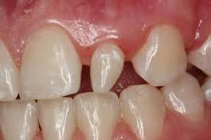
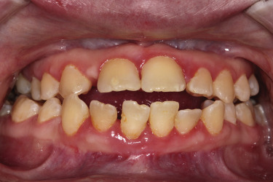
Down Syndrome (Trisomy 21)
Oral Manifestations:
Early onset severe periodontal disease
Lower incidence of dental caries
Delayed eruption of permanent teeth
Malocclusion
Anterior open bite
Congenitally missing teeth or supernumerary teeth/malformed teeth
About 50% have missing or peg laterals
Hypoplasia of midfacial region
Attrition of dentition
Mouth breathing
Narrow, high arched palate
Large/fissured tongue
Example of Peg Laterals
Example of Periodontal disease and Anterior Open Bite

Slide 14
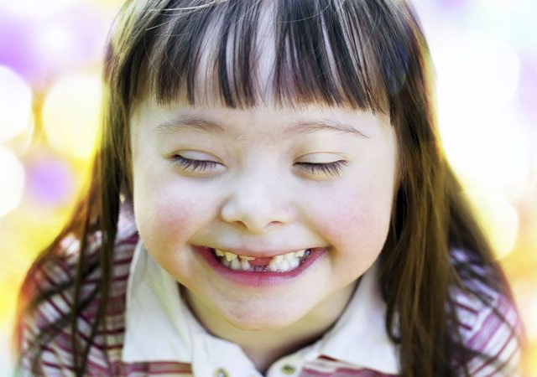
Down Syndrome (Trisomy 21)
Many children with Down Syndrome can be treated in the dental office!
Preparation prior to dental visit
Medical history
Expectations during the appointment
Careful management of movements due to possible atlantoaxial instability
If treatment is extensive, may consider General Anesthesia
After the appointment
May benefit from consultation with periodontist
Regular oral hygiene help from caregivers important
Medical consultation likely needed for future appointments
Cardiac status, premedication, etc.

Slide 15
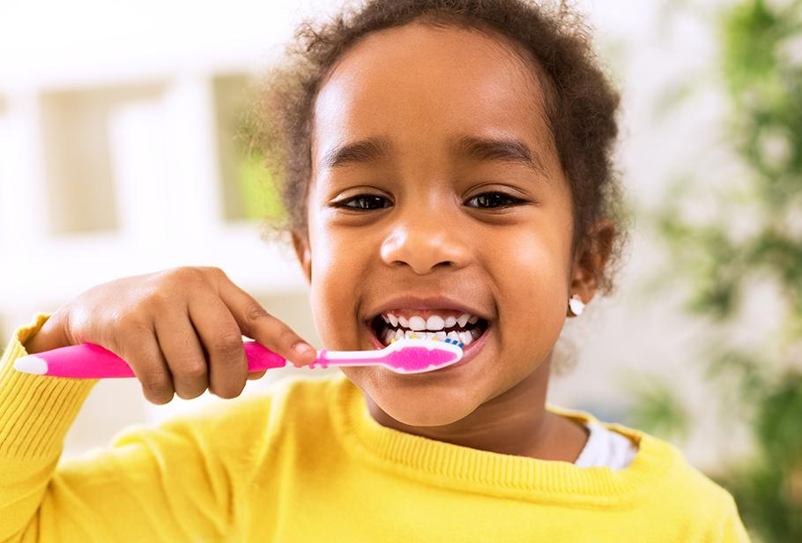
Strategies to improve oral health at home
Nutrition
Limit sugary foods/drinks
Avoid frequent snacking
Brush daily
Floss regularly (daily if possible)
Avoid sharing utensils, cups, etc to avoid transmitting bacteria causing dental disease
Personalized oral care plan updated at each dental visit!

Slide 16
NYU Langone Dental Medicine Pediatric Program - Hawaii Site
2 year Hospital and Health-Center based program
Residents are trained in:
Foundations in pediatric dentistry
Behavioral and pharmacologic management of children
Conscious sedation and general anesthesia
Treating well children and those with special health care needs
Multi-Island rotations
Oahu, Big Island and Lanai

Slide 17
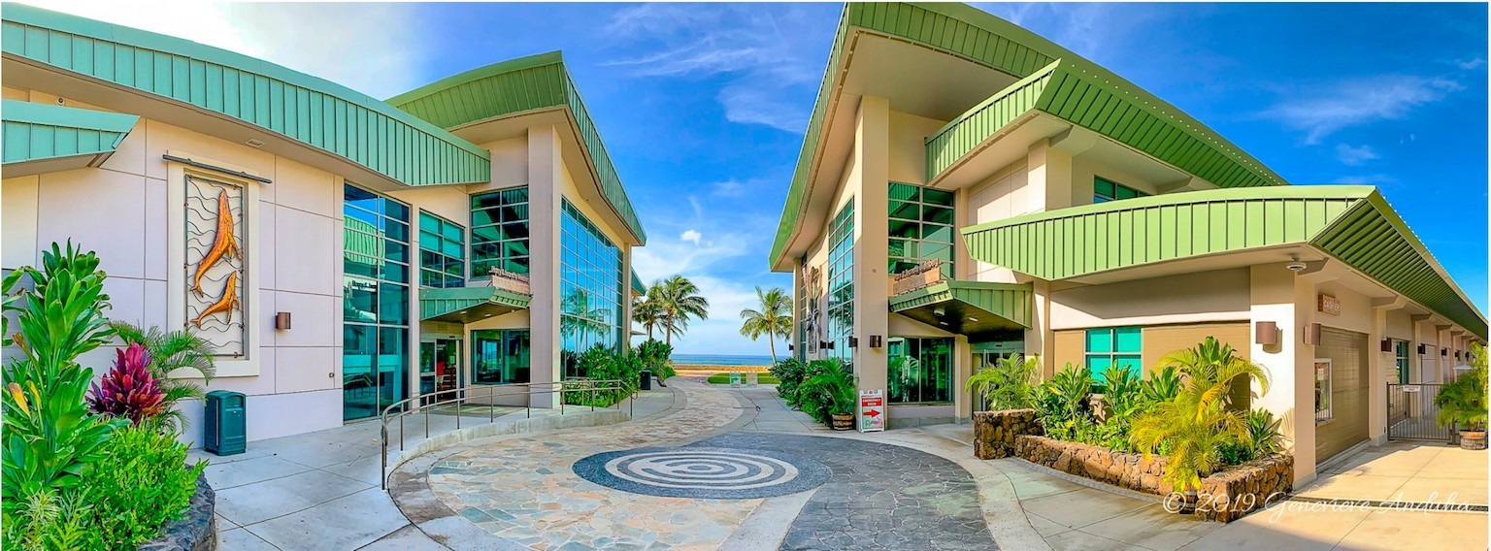
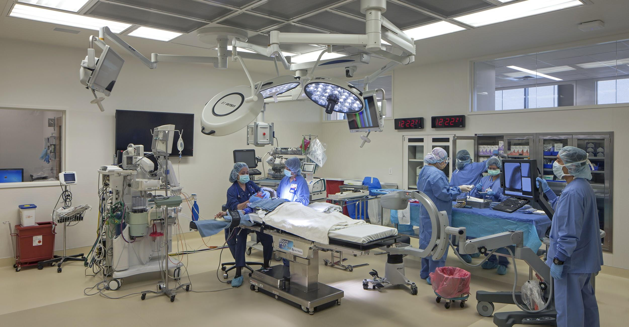
Oahu
Waianae Coast Comprehensive Health Center
Comprehensive Dental Care
Oral Sedation
Shriner’s Hospital for Children
OR general anesthesia treatment
Anesthesia training
WCCHC Dental Clinic:
86-260 Farrington Highway
Waianae, HI 96792
Phone: #808-697-3496

Slide 18
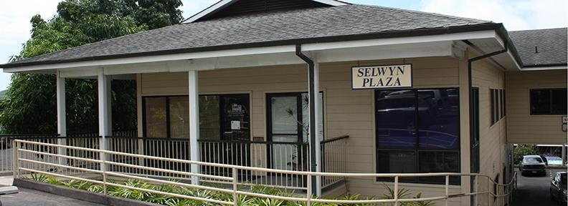
Big Island
West Hawaii Community Health Center
Keiki and Kealakehe locations
Comprehensive Care
WHCHC Kealakehe:
74-5214 Keanalehu Dr, Kailua-Kona, HI 96740
Phone: #808-355-5650
WHCHC Keiki:
81-6627 Hawaii Belt Rd # 106, Kealakekua, HI 96750
Phone: #808-323-8005

Slide 19
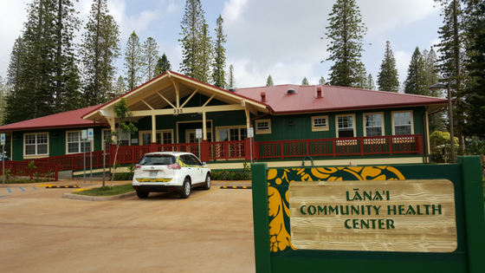
Lanai
Lanai Community Health Center
Community Outreach
LCHC Dental Center:
333 6th Street
Lanai City, HI 96763
Phone: #808-565-6919

