Slide 1
Marathon
What Skills Do You Need
& How To Develop Them
Patrick & Patricia Sheehey
May 8, 2021

Slide 2
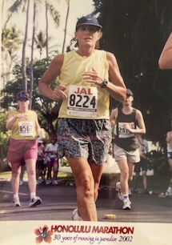
1976 2002

Slide 3
26.2 Miles

Slide 4
What Do You Need?
Plan
Motivation
Strength
Endurance

Slide 5
How Do I Get What I Need?
Know Self & Family
Network of Support
Learn to be Flexible
Smile & De-stress

Slide 6
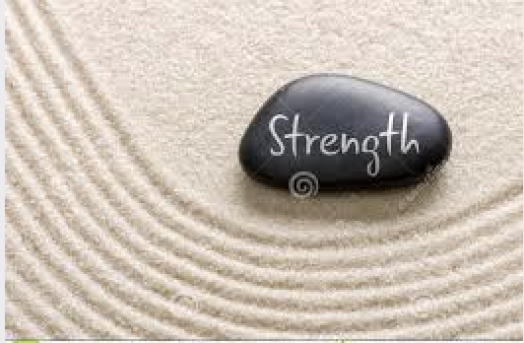
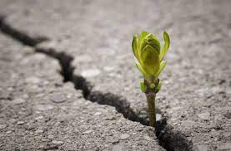
How Do I Get What I Need?

Slide 7
Know Yourself & Your Family

Slide 8
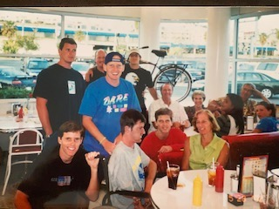
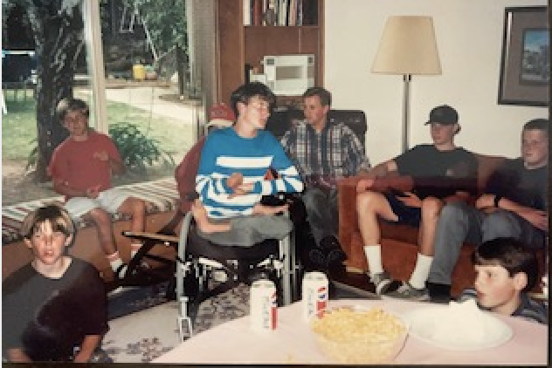
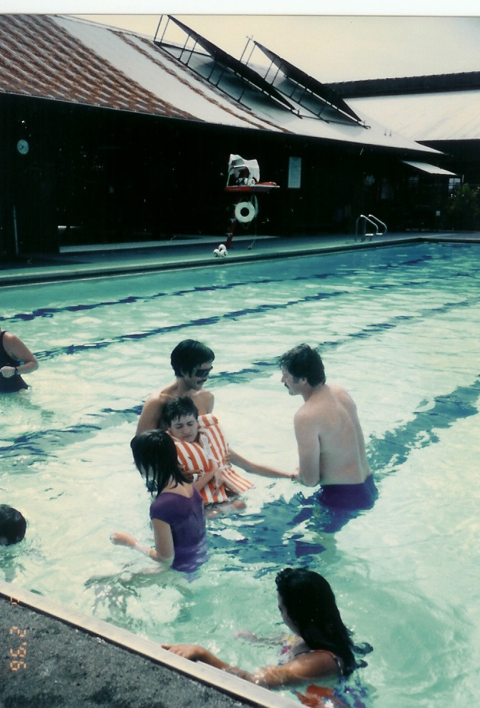
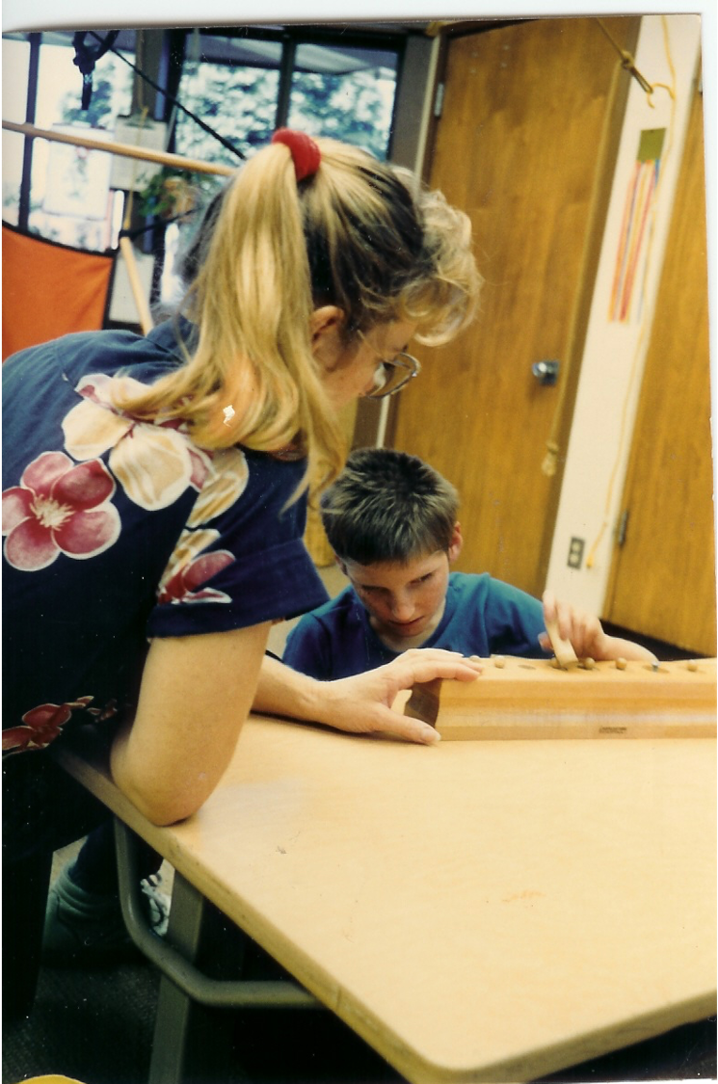
Network of Support
Family | Friends | Professionals

Slide 9
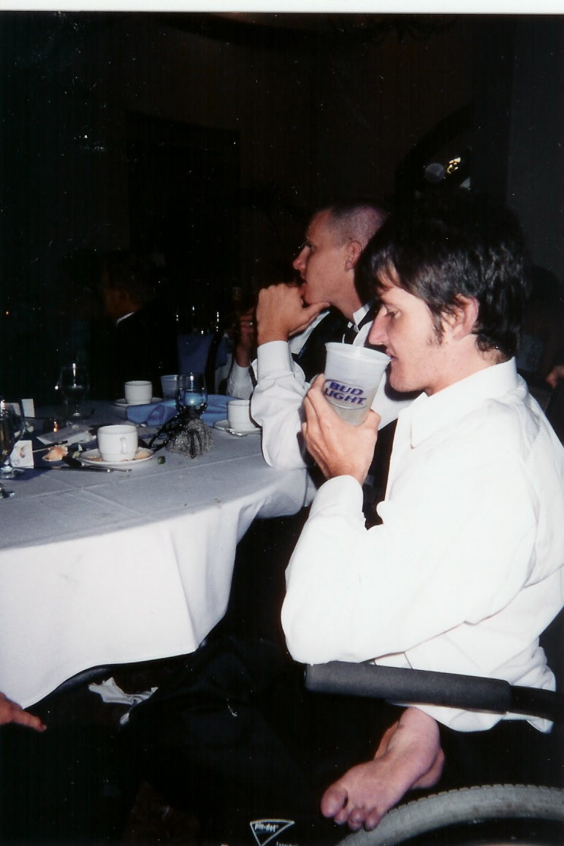
Be Flexible

Slide 10
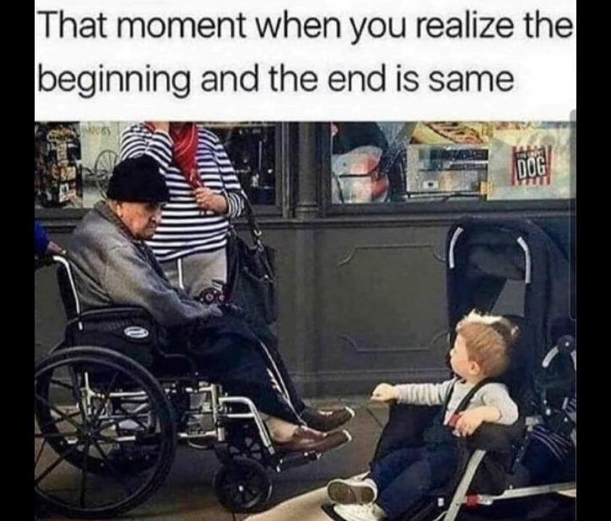
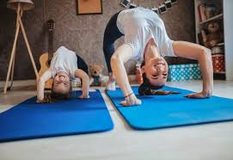
Find Opportunities to Smile & De-stress Humor, Music, Exercise, Meditation

Slide 12
