Slide 1
Find Your Happy Pace: Autism & Sensory Issues
Notes:
Gabrielle

Slide 2
Your presenters today
Gabrielle White, OTD, OTR/L
Gabrielle is pediatric Occupational Therapist at Kapi’olani Medical Center for Women and Children. She has held several roles in pediatrics including inpatient, outpatient, school based, mental health, and community settings. In her free time you can find her at the beach, surfing, or doing yoga.
Robin Putnam, MS MOT, OTR/L
Robin is a pediatric Occupational therapist at Kapi’olani Medical Center for Women and children. She has worked with children in different roles prior to becoming an OT including pre-school teacher and school counselor. As an OT she has worked with children and families in the private clinic, school, and hospital settings.
Notes:
Both

Slide 3
Objectives
Overview of the role of occupational therapists in assessing the impact of sensory processing differences for the child.
Identify sensory processing differences that may affect a child with autism.
Occupational therapy’s role in supporting families and children with sensory processing difficulties as they affect behavior and regulation.
Introduce general sensory strategies.
Share resources to access additional information about autism and sensory processing.
Notes:
Gabrielle

Slide 4
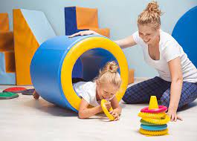
Occupational Therapy and Sensory Processing
What is OT?
Pediatric Occupational therapy uses engagement in meaningful activities to help children participate in their daily routines. The work of childhood is to play, learn, move, and grow as they interact with the world and people around them.
What is an OT’s role in sensory processing?
Assessment
Intervention
http://www.holisticlc.com/sensory-integration-occupational-therapy/
Notes:
Robin
Sensory processing is typically assessed through a questionnaire, observation of the child during the session, and parent feedback about specific behaviors. (OTs do not diagnose ASD or SPD)

Slide 5
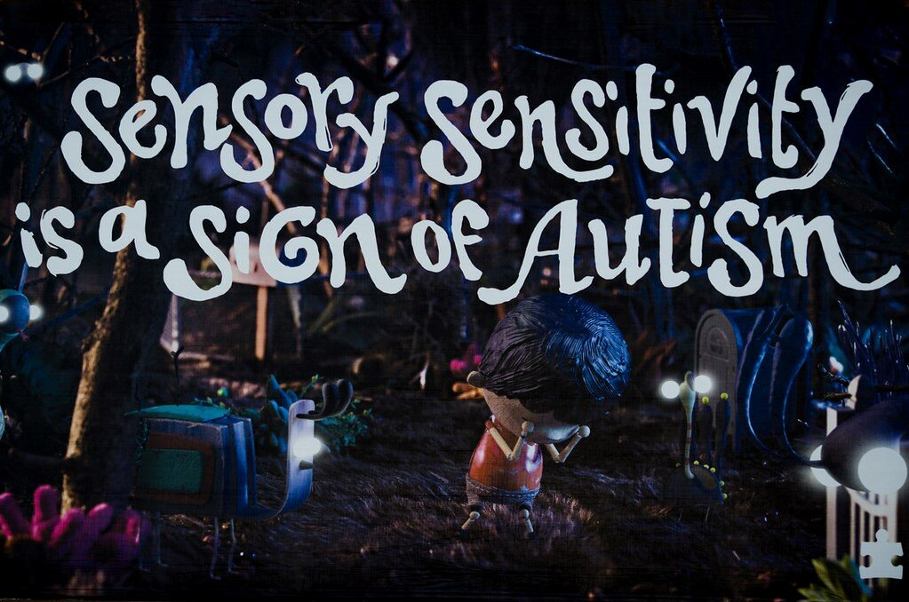
ASD & Sensory Processing
Do all people with Autism have sensory processing problems?
Does having a Sensory Processing Disorder mean someone has Autism?
What is the difference between sensory preferences and a sensory disorder?
(Autism Speaks, 2019)
Notes:
Robin

Slide 6
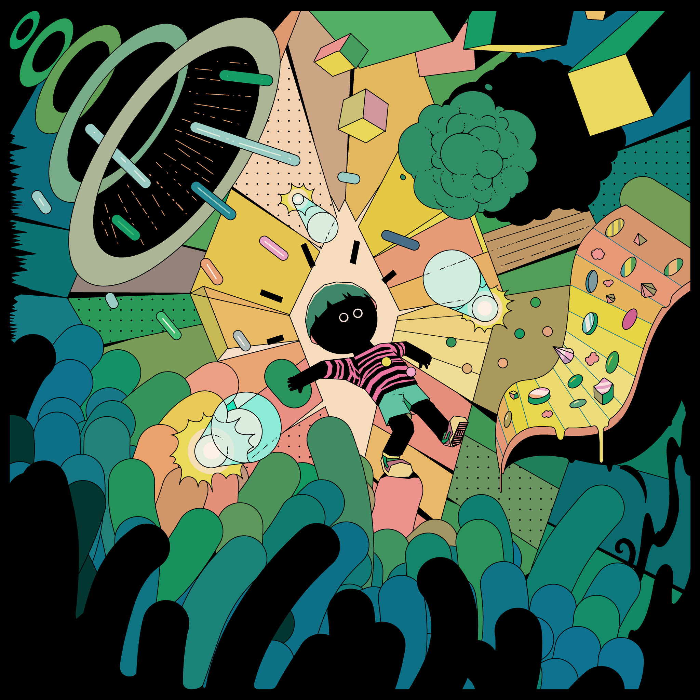
What do all these terms mean for my child?
Sensory Integration/Sensory Processing
Regulation
Dysregulation
Under Responsive
Sensory Sensitive
Sensory Seeker
Deep pressure
Heavy work
Stimming
Sensory Diet
https://www.nytimes.com/2020/04/17/parenting/sensory-processing-disorder-kids.html
Notes:
Robin
Sensory Integration/Sensory Processing- is the effective registration (and accurate interpretation) of sensory input in the environment (including one’s body). It is the way the brain receives, organises and responds to sensory input in order to behave in a meaningful & consistent manner.
Regulation- How we shift and maintain states according to the demands of the environment. In a balanced sympathetic/para-sympathetic nervous system ‘regulation’ toggles between unconscious and conscious as we shift between states of arousal according to internal and external context-dependent demands.
Dysregulation- Sensory dysregulation is when you have an imbalanced central nervous system (your brain) due to an excess of sensory input, or not enough sensory input.
Underresponsive- Under-responsive to sensory information. A generalization could be that Hyposensitivity results in a tendency to crave intense sensations or to withdraw and be difficult to engage.
Sensory Sensitive- : Over responsive to sensory information. A generalization could be that Hypersensitivity results in tendency to be fearful and cautious or negative and defiant.
Sensory Seeker- person who has a high threshold (or a large sensory cup) for sensory input. This means that in order for that person to register, acknowledge, recognize or notice that input, they require a lot more frequency, intensity or duration of the input than someone with a typical threshold
Deep pressure- firm tactile sensory input that provides proprioceptive input to the whole body
Heavy work- Heavy work is activity that requires effort from our muscles and these tasks usually involve pushing or pulling or lifting.
Stemming-also known as self-stimulating behaviors or stereotypy, are repetitive body movements or repetitive movements of objects
Sensory Diet- A prescribed list of multi sensory experiences designed to support function and participation throughout the day.

Slide 7
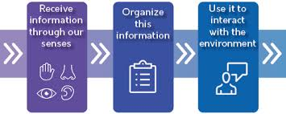
What is Sensory Processing
The way the brain receives, organizes and responds to sensory stimulation in order to behave in a meaningful & consistent manner.
(Pathways, 2023)
Notes:
Gabrielle

Slide 8
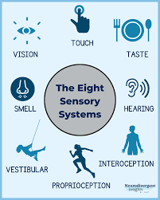
Our 8 Sensory Systems
Visual
Auditory
Gustatory
Olfactory
Tactile
Proprioception
Vestibular
Interoception
Notes:
Gabrielle

Slide 9
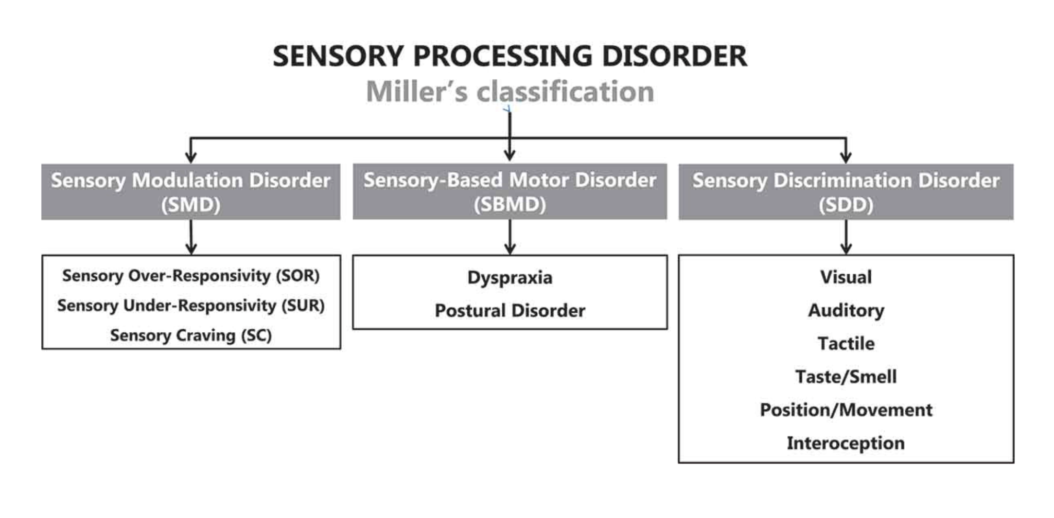
Subtypes of SPD
(STAR Institute, 2023)
Notes:
Gabrielle

Slide 10
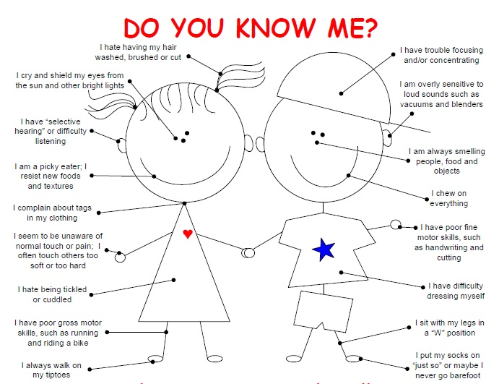
Sensory Modulation Disorder
All 3 share difficulty grading or regulating responses to sensory stimuli
Over-responsive: Responds too much, for too long, or to stimuli of weak intensity.
Under-responsive: Responds too little, or needs extremely strong stimulation to become aware of the stimulus.
Craving/Seeking: Responds with intense searching for more or stronger stimulation.
(STAR Institute, 2023)
Notes:
Robin

Slide 11
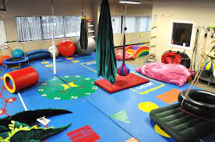
Sensory Based Motor Disorder
Postural disorder: which reflects problems in balance and core stability
Dyspraxia: encompasses difficulties in motor planning and sequencing movements.
(STAR Institute, 2023)
Notes:
Robin

Slide 12
Sensory Discrimination Disorder
Difficulty interpreting the specific characteristics of sensory stimuli (e.g., the intensity, the duration, the spatial, and the temporal elements of sensations.
The ability to discriminate (or identify) sensory input, sensory differences, quantities, and qualities of sensory stimuli.
Can be present in any of the sensory systems.
(STAR Institute, 2023)
Notes:
Robin

Slide 13
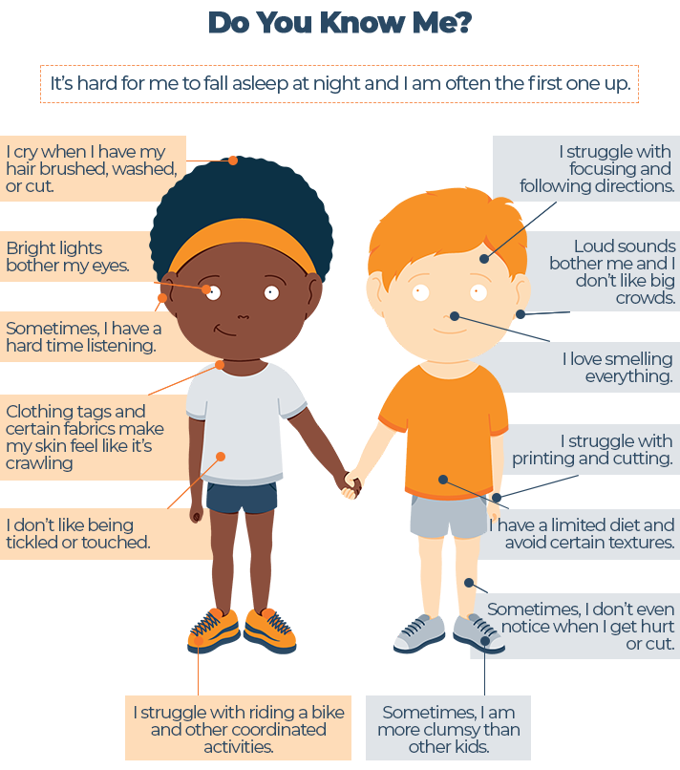
How does this impact my child?
Attention
Motor skills
Emotional regulation
Behavior
Self esteem
Self-care
https://www.sleepadvisor.org/sensory-processing-disorder-and-sleep/
Notes:
Gabrielle

Slide 14
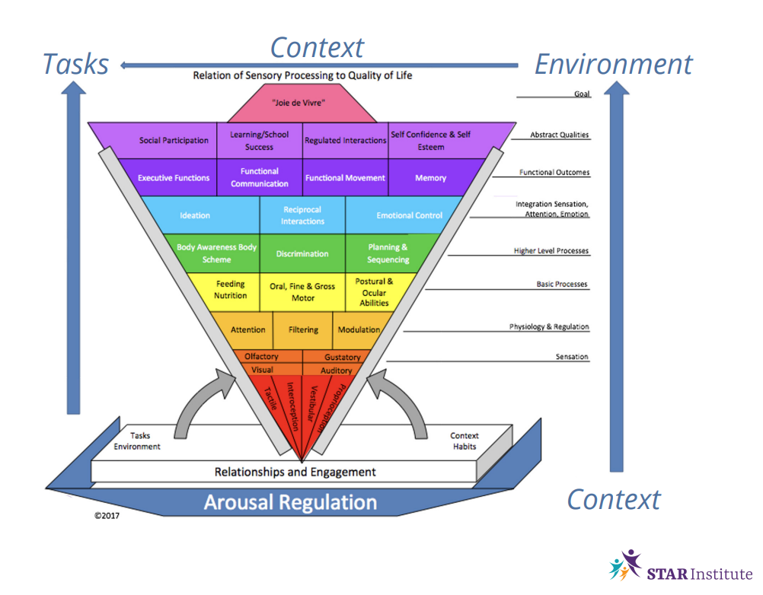
Notes:
Gabrielle

Slide 15
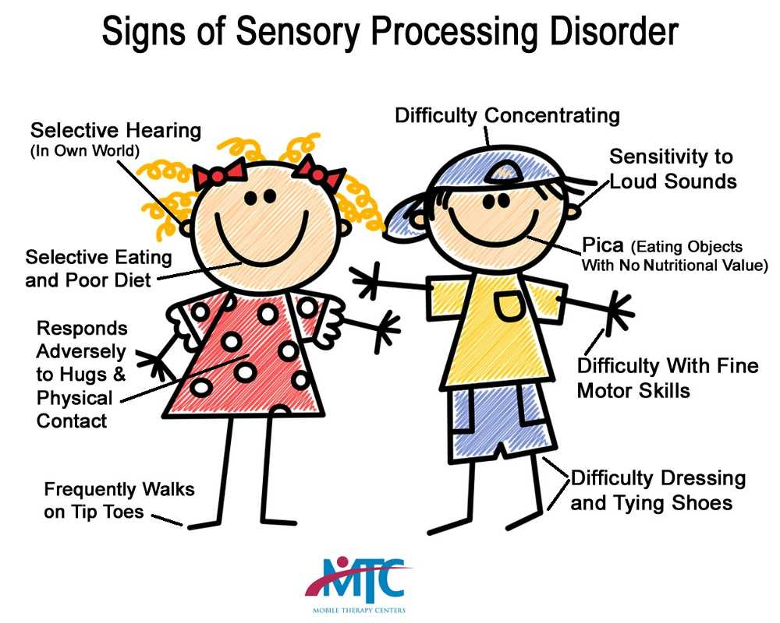
Your Child’s Sensory Preferences vs. Your Sensory Preferences
We all have sensory preferences
What kind of environment so you like when working on a project or studying?
How do you like to decorate your space?
You and your child may be similar or very different.
https://mtcus.com/what-is-a-sensory-processing-disorder/
Notes:
Gabrielle

Slide 16
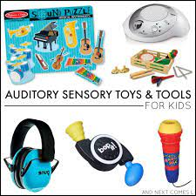
Auditory Sensory Tools
Calming
Soft soothing music
Music with simple melodies
Rhythmic music
Familiar expected voices
Familiar songs
Noise dampening headphones
Voice with an even tone
Metronome
Alerting
Loud or fast paced music
Songs with irregular beat (jazz)
New songs or sounds
Alarms (high pitched, loud)
Frequent changes in volume
Notes:
Robin

Slide 17
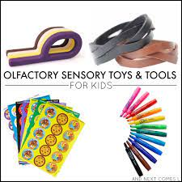
Olfactory (smell) Sensory Tools
Calming
Scented lotions, smell bottles, on a cloth to hold (Vanilla, lavender, coconut scents)
Familiar smells associated with pleasant memories
Alerting
Lemon, peppermint, pine
Scented markers
Distasteful smells
Smells associated with stressful memories
Notes:
Robin

Slide 18
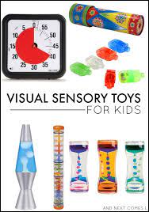
Visual Sensory Tools
Calming
Cool colors ( blues and greens)
Lava Lamp
Snow globe
Calming bottle
Dim lights
Predictable patterns
Blank walls
Timers
Alerting
Bright colors
Bright lights
Fast paced videos
Busy decorations
Notes:
Robin

Slide 19
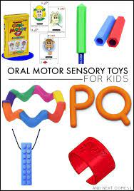
Oral Sensory Tools
Calming
MIld or sweet flavors
Blowing bubbles
Blowing a pinwheel
Drinking through a straw
Chewy snacks
Chewing gum with fruit or sweet flavors
Warm foods
Alerting
Strong flavors
Spicy, sour, mint
Crunchy snacks
Cold foods
Carbonated beverage
Notes:
Gabrielle

Slide 20
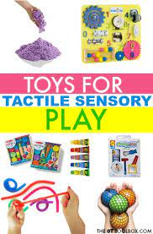
Tactile Sensory Tools
Calming
Soft textures
Firm pressure/hugs
Massage
Warmth (in a blanket, warm bath/shower, cuddling)
Water play
Sensory bin (depends on textures the child tolerates)
Alerting
Rough textures
Light touch
Cool temperatures
Unexpected touch
Vibration
Sensory bin (depends on textures the child tolerates/enjoys)
Notes:
Gabrielle

Slide 21
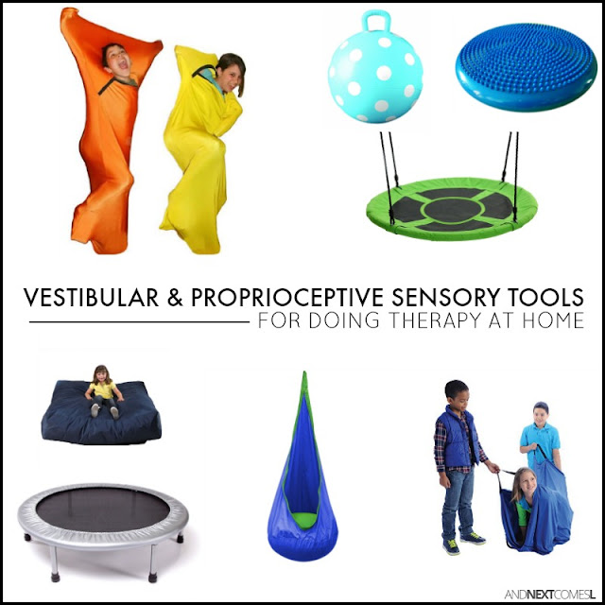
Vestibular Sensory Tools
Calming
Slow back and forth swinging
Rocking
Rhythmic movement
Walking
Air cushion in the chair
Alerting
Fast vertical movement
Spinning (no more than 10 repetitions at a time – do not do this if there is any known heart or seizure history)
running
Riding a bike/scooter
Upside down positions
Sudden starts and stops
Notes:
Gabrielle

Slide 22
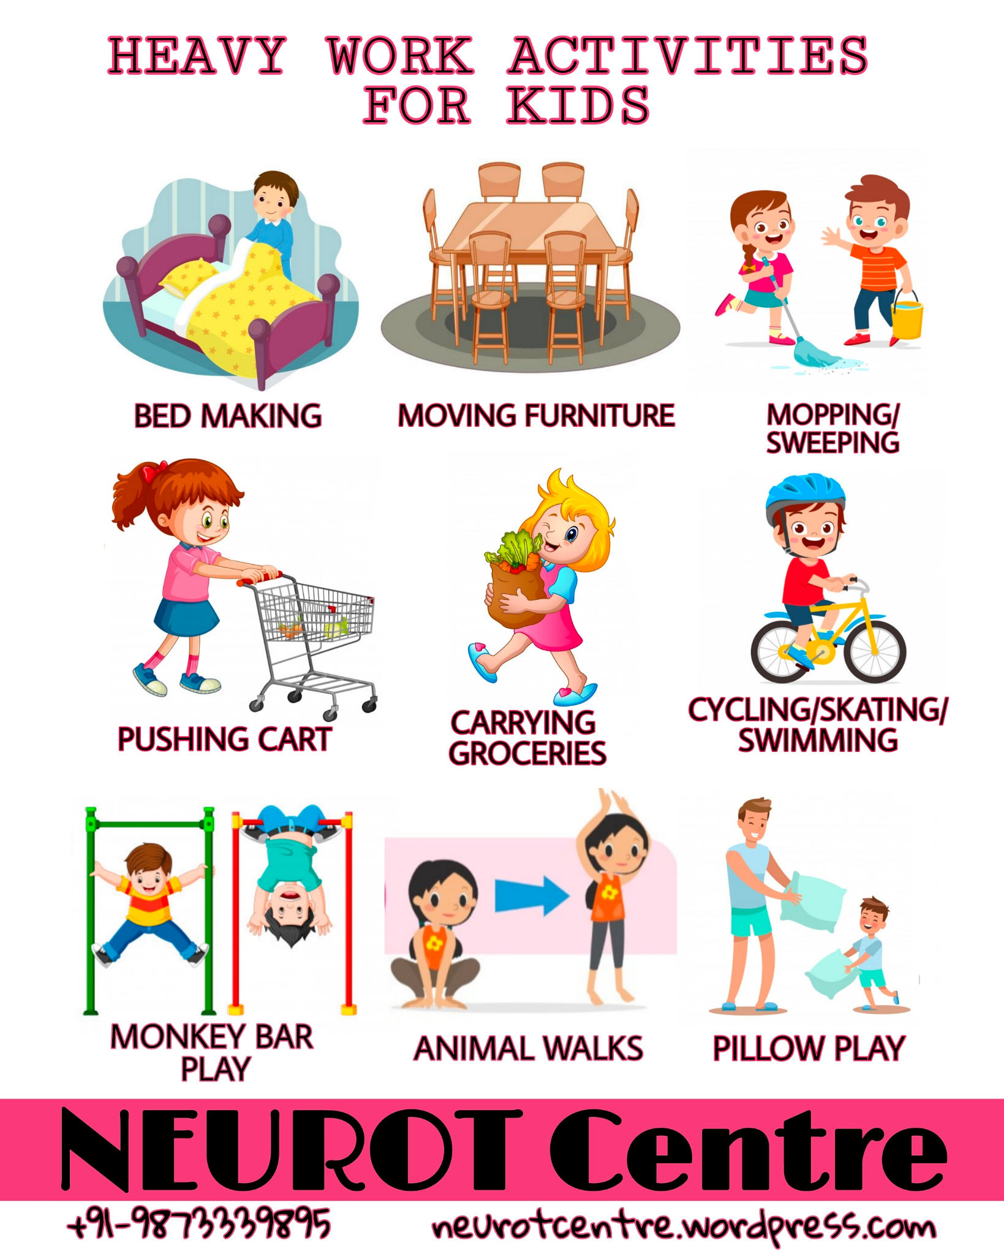
Proprioceptive Sensory Tools
Calming
Heavy work (lift, push, carry something heavy)
Yoga
Pillow squishes
Joint compression
Isometric exercises (wall pushes)
Activities with resistance
Weighted products (max 10% of the body weight)
Small, safe places
Sqeeze a stress ball
Hang from monkey bar
Familiar pattern of movement
Theraband around chair legs
Alerting
Frequent change in position
New pattern of movements (new dance moves, new playground)
Notes:
Gabrielle

Slide 23
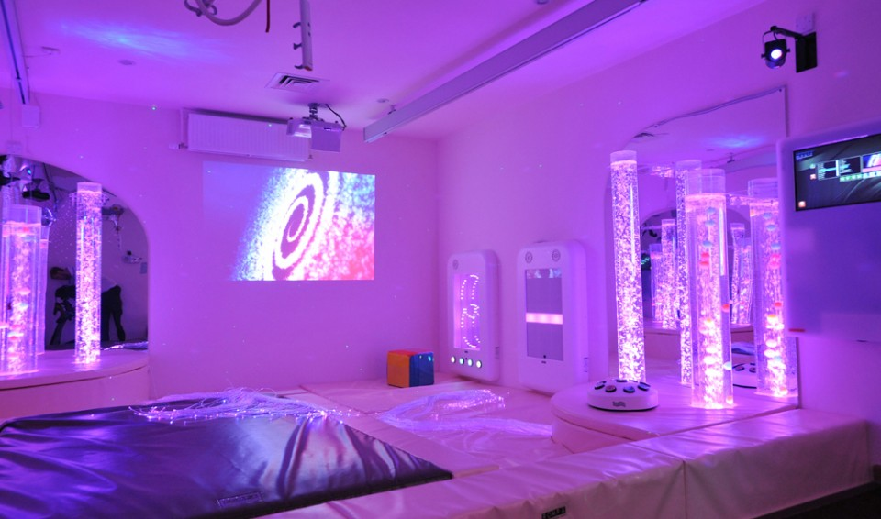
The Environment
Where were you?
Time of day?
What was your child doing?
Who was around?
What were you doing?
Lighting, sounds, smells, etc.?
How did your child sleep the previous night?
What did your child eat that day?
https://www.snoezelen.info/
Notes:
Robin

Slide 24
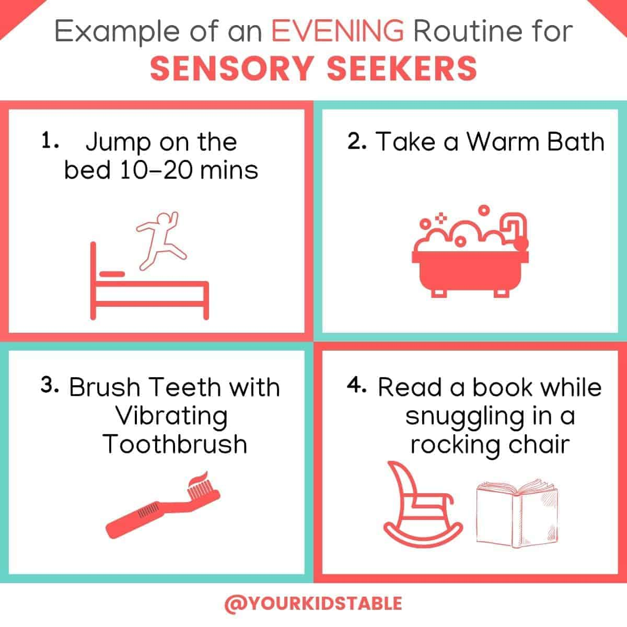
Routines & Structure
Patterns of behavior that are observable, regular, and repetitive and that provide structure for daily life.
Can be satisfying, promoting, or damaging.
Routines require delimited time commitment and are embedded in cultural and ecological contexts.
Notes:
Robin

Slide 25
Parent Resources
Information and Education
STAR Institute (sensoryhealth.org)
Autism Speaks
Understood.org
Pocketot.com
Community Based Programs
Special Olymics Hawaii
Access Surf Hawaii
Never Quit Dreaming
Safe Swim ASD at UH Manoa
Notes:
Robin

Slide 26
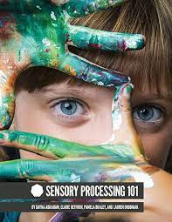
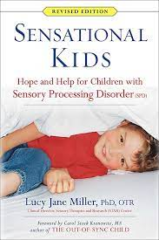
Recommended Reading
Notes:
Gabrielle

Slide 27
Thank You!
Questions or Comments?

