Slide 1

Building Better Family/School Partnerships
Strategies & Communication Tools
By Amanda Kaahanui & Susan Rocco
Special Parent Information Network

Slide 2
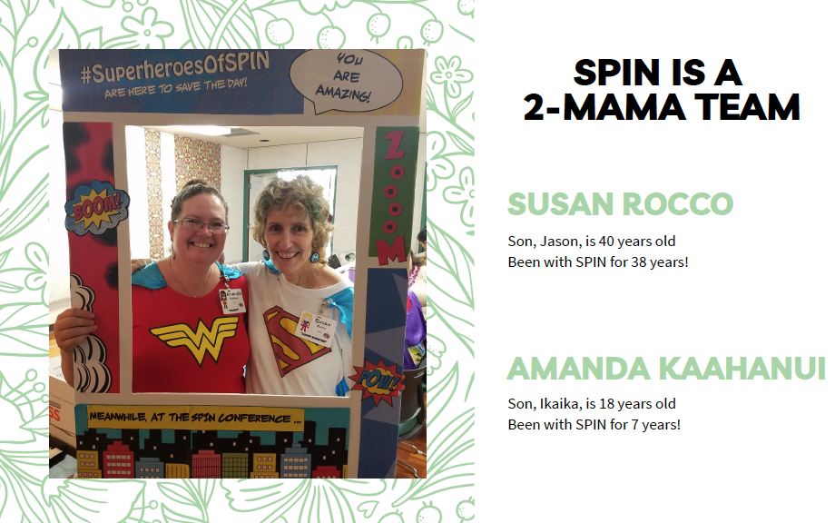
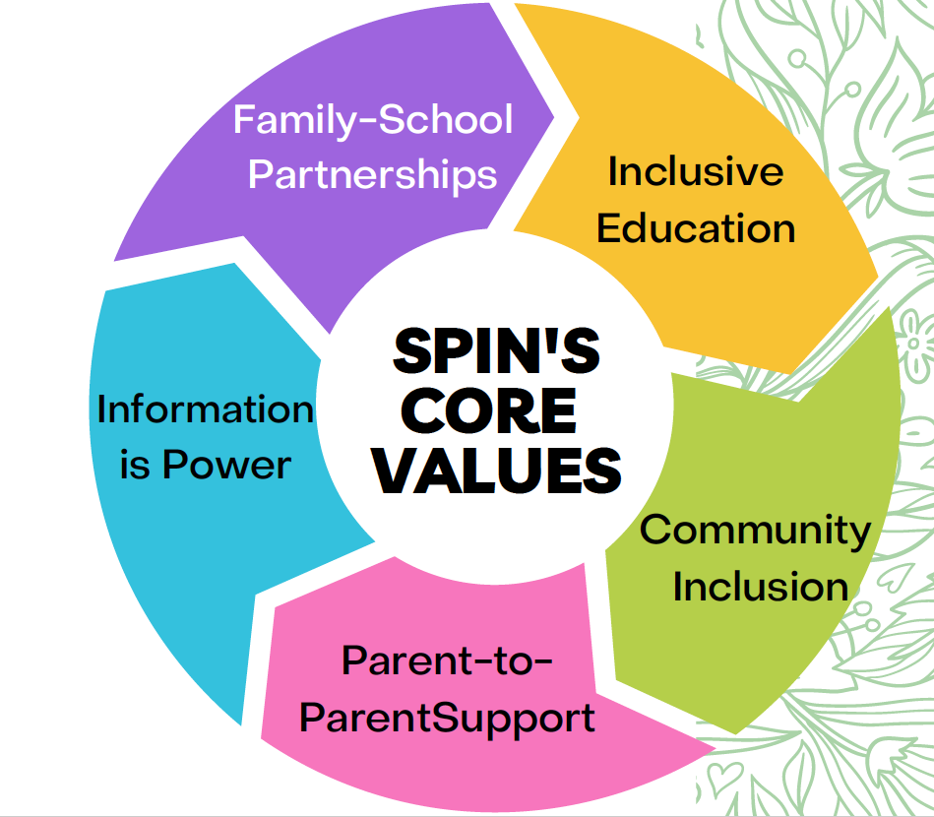
Aloha from SPIN
Son, Jason is 41 years old
Been @ SPIN for 38 years!
Son, Ikaika is 19 years old
Been @ SPIN for 8 years!

Slide 3
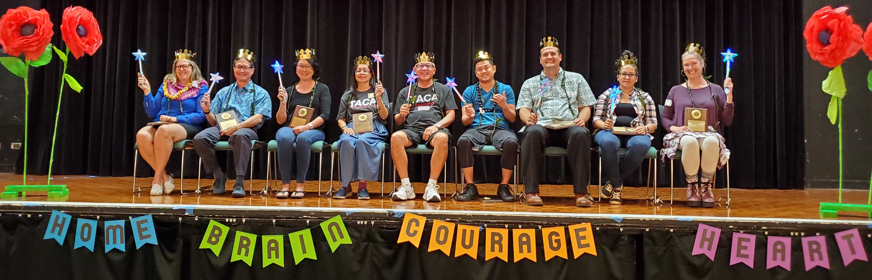

Our Kuleana
2019 SPIN Award Winners
Showcasing parent and professional leaders in our community.
Notes:
In addition to SEAC, Amanda is on the Footsteps planning committee and Post secondary work group and Susan is on the EBS committee and Statewide family engagement advisory group.

Slide 4

Who’s Here today?
Teachers
Parents
EA’s, OT/PT, SLP &
Related Services
School Admin
District Staff /
Resource Teachers
State Office Staff
Notes:
Now you know a little about me, lets find out about you!
ONline, use an emoji to tell me who's here

Slide 5

Mahalo SPED Teachers!
Notes:
For all our teachers, staff, and related service providers - we appreciate you!

Slide 6

Let’s Play a Quick Game
Get 1 point for each thing you have NEVER done.
0-5 pts – 3 candy
5-10 pts – 2 candy
11+ pts – 1 candy
Notes:
If you are a parent or have not worked in the classroom, you can apply these questions to your own life experiences.
The alternative title of this game is “Chocolate Saves Lives” or “Start the meeting with Chocolate”
This is a strategy I used when starting an IEP meeting. I’d bring chocolate and fruit to tired staff after a long day.
Pass around the Hershey Kisses bowl and take as many as you need. We are not grading today!

Slide 7
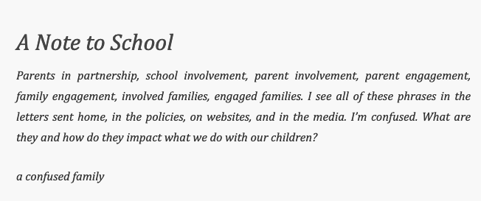
What’s in a Name?
Involvement
Engagement
Partnership
Above graphic and Family-School Partnership checklist available at:
https://familyengagement.nipissingu.ca/2014/10/23/partnership-engagement-involvement-is-it-really-just-semantics/
National PTA Standards on Family-School Partnerships
https://www.pta.org/home/run-your-pta/family-school-partnerships
Notes:
Today, we’re talking about Family-School partnerships. But what do we mean by that? Lets think of it as a continuum.

Slide 8
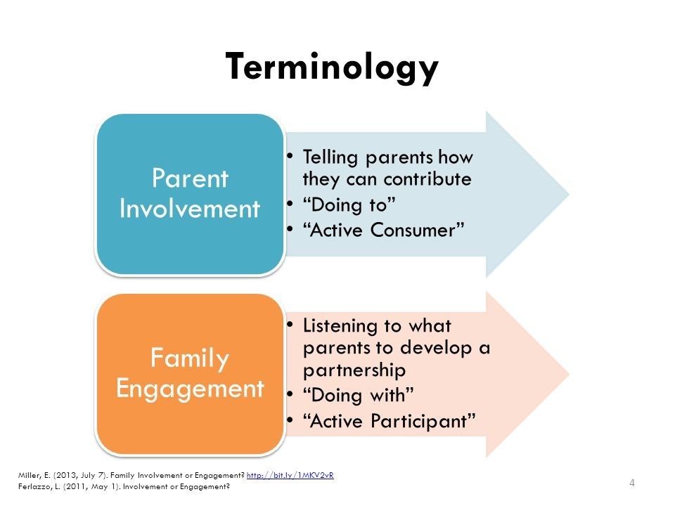
Involvement, Engagement, Partnership
What’s the difference?
Open house night
Field Trip Chaperone
School Fair (bring a treat to sell)
Volunteer in the classroom
Science Night (or any other “night”) as fun activities to do
PTSA member
Reads newsletters or the website for info
The school decides how a parent can be involved
Oftentimes, it is the school that establishes the context of the relationship it will have with parents by determining what initiatives, goals, and needs will be addressed. The parents participate in these endeavors; however, their voices are often removed from the process. This outcome is acceptable as “almost all the research says that any kind of increased parent interest and support of students can help” (Ferlazzo 2011).
https://parents4publicschools.org/family-involvement-vs-family-engagement-whats-the-difference/
Notes:
I invited parents to Open House, they came, saw my room, said hello and then left. But they didn’t really get to tell me that all the wonderful decorations in my room were a bit overwhelming to their child and could be the reason they are not ”paying attention” in class.

Slide 9
Involvement, Engagement, Partnership
What’s the difference?
Ask parents how they would like to be a partner with the school – then work with them to make it happen
Parents as guest speakers or co-presenters
Math Night (or any night) that teaches parents how to do homework with their kids
Active PTSA members & leaders
Encourage SCC participation, even if you have a parent on your council, invite others to join
Families are part of decision making at the school
According to research, in instances where parent engagement is the emphasis, student achievement is greater. “Family engagement can produce even better results—for students, for families, for schools, and for their communities” (Ferlazzo & Hammond, 2009). When parent engagement is the focus, parents are in partnership with the school. In these parent-school partnerships, parents are welcomed, heard, and serve an integral role in the decision-making process.
https://parents4publicschools.org/family-involvement-vs-family-engagement-whats-the-difference/
Notes:
If you invite me to a Principal Talk Story and let me share some ideas with you about the drop off route at school, and then you make some changes based on parent feedback, I’ll be more inclined to come to the next meeting. And I’ll feel proud that I helped make the school better for all families, not just mine. I’m a part of the school community!
And please remember that if you have a Principal Coffee Talk at 9:00 am on Tuesday, you are only reaching parents who do not work, don't have young kids at home and have the time in the day to come. I always wanted to go, but never could due to work committements.

Slide 10

Parent Partnerships: National PTA Standards
Involvement
Engagement
Partnership
Notes:
The National PTA has standards for Family School Partnerships. And the Hawaii BOE has adopted these 6 standards. This happened at the urging of Parent Advocates for several years in a row.
A word about #6 - Our School Community Council has community members. I'm one of them, since my kid graduated last year. But there are other ways to include community members and business into your school community.

Slide 11

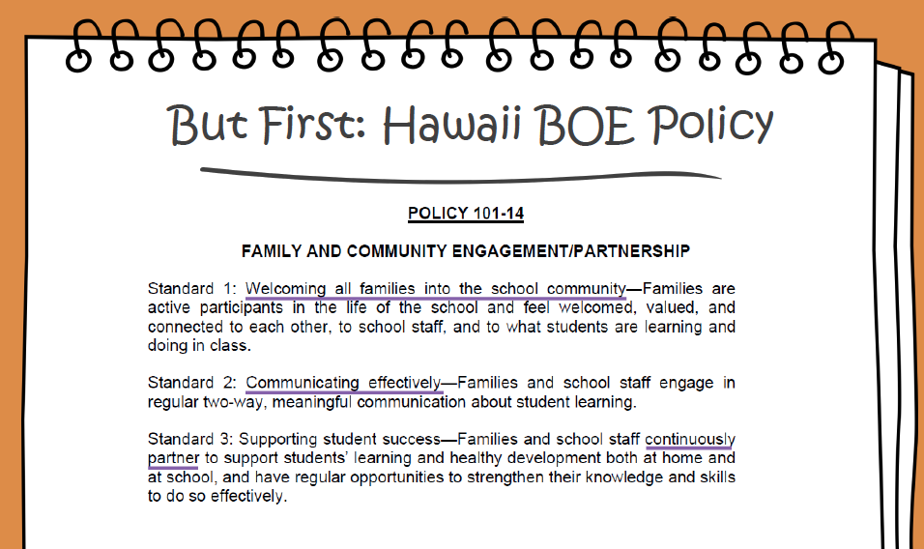
HIBOE on Family Partnership
Notes:
The Hawaii BOE adopted the National PTA standards for family-school partnerships. Here are the 6 standards

Slide 12
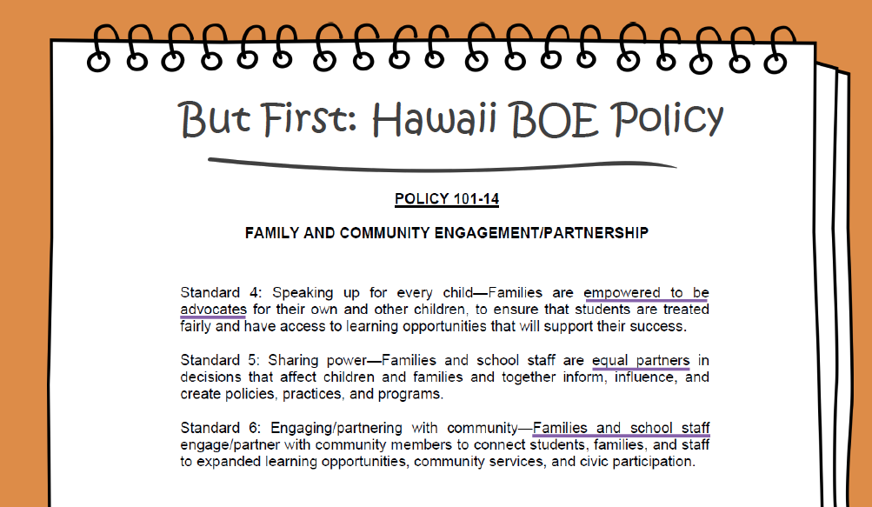
HIBOE on Family Partnership

Slide 13
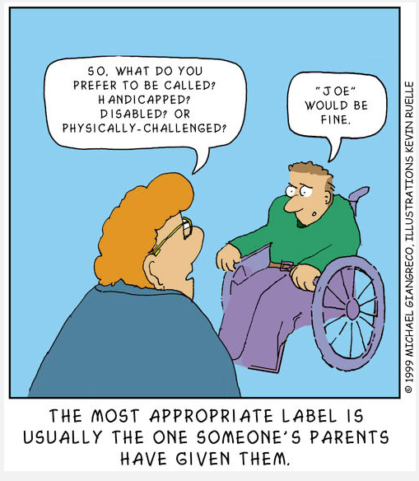

Let’s Talk about Bias, Filters & Perspective
Notes:
If you’re here today, you are already in the right mindset to build relationships and partnerships with families. Thank you for that!
Before we dive into the meat & potatoes of our presentation, lets first talk about bias and perspective. We all have bias. Sometimes we know what it is and sometimes it’s a part of us that we didn’t really think about. It can be a part of our upbringing or lived experience. We’re starting here, b/c depending on your bias about family/school partnerships, you could be defeated before you begin, and acknowledging we have bias is the beginning of getting over that bias.

Slide 14
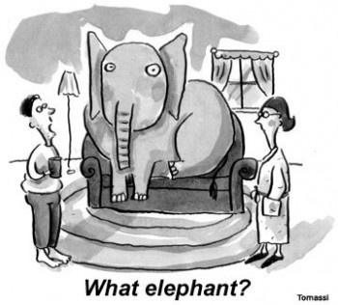
Implicit Bias: The Elephant in the Room
An implicit (or unconscious) bias is an attitude or stereotype we hold without being fully aware of it.
Biases are the stories we make up about people before we know who they actually are.
Everyone has some implicit biases, we cannot be completely free of them.
We can work to reduce them.
Research shows that reducing implicit bias removes barriers to helping each other and increases cooperation.
https://www.happybrainscience.com/blog/how-to-use-a-fun-party-game-to-tackle-implicit-bias/
Notes:
I remember when my son was in elementary school, I felt we had a really good working relationship and partnership. I felt we were on the same page most days. in middle school, at the end of 8th grade, I was told “You know, we were warned you were one of “those parents”, but I don’t find you unreasonable at all." The school had a working bias about me before they even knew me and they had to work harder to get over it.
Imagine you are ready to meet a new family and you’re ready with the welcome mat and full of happy smiles and aloha. Then you get a “helpful warning” from another teacher/school/admin that the parent is difficult and wants too much. How does that “helpful warning” change your bias towards that parent?

Slide 15
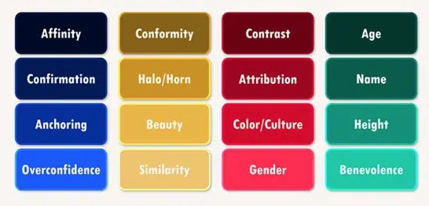
Types of Bias
https://symondsresearch.com/unconscious-bias-quiz/
Disability
Notes:
These are the different kinds of bias. Look how disability bias is NOT included here... was that someones bias?

Slide 16
Here are a few examples of bias.
Can you think of more?
Horn Bias: Opposite of Halo – one bad thing the person does assumes everything they do is bad.
Example: She’s terrible at math, she should be in resource or FSC all day.
Affinity Bias: Favoring someone because they share something in common with you, like similar interests or educational background.
Example: Oh, you went Kamehameha? Me too! We are instant besties! Oh, you went to school on the mainland? I don’t even know how to connect with you, we’re too different.
Conformity Bias: Is linked to our desire, as humans, to fit in. Instead of using our own judgement, we do what others are doing.
Example: How many of you first thought autism looked like “Rainman”? Or that a deaf person could not speak. Or Micronesians don’t engage?
Halo Bias: When one good quality of a person is used to assume everything they do is good, without looking at the evidence.
Example: He smiles all the time, he must be such a happy child.
Similarity Bias: We tend to trust and like people who are like us while distrusting and don’t like people who are different from us.
Example: We ladies have to stick together, or I don’t trust the principal, they are all bad.
Notes:
share one at a time. Ask for examples, give candy.

Slide 17
Bias is not only how you perceive the world, students and families, and how you interact with them, it’s also how you share resources, information and what kinds of supports YOU think the family needs.
How can Bias affect how you interact with students and families?
How can you change it?
 | Deaf Kids | DD/ID Kids | G-Tube Kids | Parents
Bias by - school staff - medical staff - other parents - other students - family members | They SHOULD: - sign - talk - use hearing aids (or not) - go to HSDB (or not) | They SHOULD: - get guardianship - get a certificate - learn laundry skills - join a day program - not be included | They SHOULD: - not use playground - eat by themselves - only be given ”real” food | They SHOULD: - not baby their kid - help with homework - attend all meetings/events - trust the school/experts
What we can do instead | Give information across spectrum of language, technology and education placements so families can make informed choices | Share alternatives to guardianship, talk about inclusion classes, even if they don’t get a diploma, ask what skills they need or want to learn | Ask for training about g-tubes (parents can do this). Ask how the school can support the student while they eat. Let them eat in the cafeteria. | Ask parents what they need: training, support, advice. Trust that parents are doing the best they can at the moment, and they know their child best.
Standard for all | Connect them to resources, support organizations and other families | Connect them to resources, support organizations and other families | Connect them to resources, support organizations and other families | Connect them to resources, support organizations and other families
Notes:
for Deaf - parents have to make a communication, school placement and technology decision when their child is 3! Keep offering choices and information and let them know it's ok if they change their mind later.

Slide 18
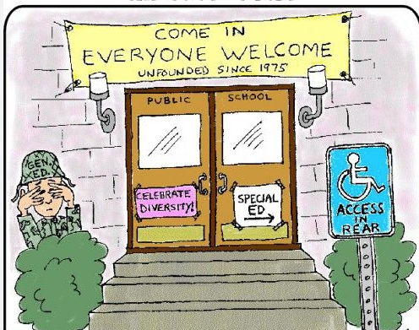
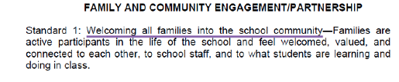
Standard 1: Welcoming all families into the school community.
Notes:
Now that we’re all going to work on reducing our biases, lets take a look at the Family School Partnership standards. If your campus is still closed, how do you welcome families?

Slide 19
What do we mean by School Community Inclusion?
How welcoming is your front desk to families?
Do sped families volunteer at your school? Is the PCNC able to reach out to them?
At Open House night, is the sped room open? Are kids invited to the gen-ed room too?
Are sped families tapped to be chaperones for school field trips? (are the kids invited?)
Do the sped kids get a flyer for school spirit week?
If you have a PTA, how many sped families are involved? (I’m not fundraising for a class or school that does not include my kid)
If your school has a school store, are kids with disabilities working in it? Do they get a chance to buy from it?
Do you invite parents to academic planning meetings? (If my kid does not have access to gen-ed curriculum, I don’t care about it)
Are sped kids invited to attend prom? Football games? School assembly? (are they with their home room or sped room?) How do they get invited?
Do you have a sped parent on your School Community Council? (You can have more than one parent and it’s better if it’s not a teacher or other staff member)
If you have transition events at your school, do you include sped? Is it inclusive or separate?
How else could you include families at your school?
Notes:
Families who have kids in sped often do not feel apart of the school community. We are left out of academic discussions. You may invite them, but if their child is not accessing the gen ed curriculum, what stake do they have in the curriculum and academic testing? Kids are often in separate rooms, or even separate wings of the school. I attended an elementary to middle school transition night. there were no sped teachers present. What do you think my impression of the school was? (and this was an inclusion school).
Also, remember that school IS community for our kids. you don't have to take them off campus to have community-based instruction.

Slide 20
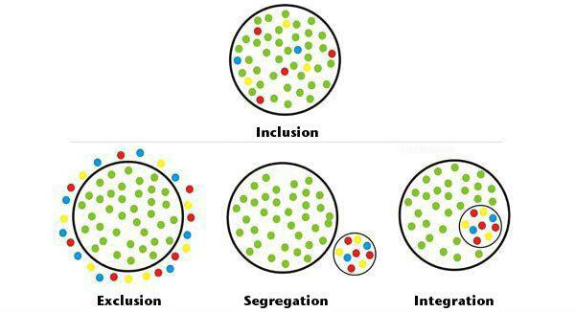
Remember this inclusion graphic?
Let’s apply it to School Community Inclusion

Slide 21
School Community Inclusion
Shared visions, ask for feedback & use it, included on school councils, trainers,
co-presenters, shared expertise.
Partnership
We know best
Involvement
Engagement
If we need you, we’ll ask
We are the professionals
Read our Newsletter
Get info from the website
Join the PTSA/SSC
Come to a math night
Notes:
Now lets look at it from a School Community Inclusion model.
Exclusion becomes “We know best”
Segregation becomes Involvement – still on the outside, looking in
Integration becomes Engagement – come in, but stay in your lane
Inclusion is Partnership – working together for a shared vision of student success.

Slide 22

Inclusion game -in person – 5 minutes
Reverse Musical Chairs Game
Start with 7 chairs/8 players
Play music, walk around the chairs
When the music stops, find a seat
How does it feel to be excluded?
How does it feel to find solutions to include everyone?
Children with disabilities are often excluded, or are an afterthought, to school activities, field trips, curriculum, clubs, sports and natural friendships. Families are too.
Sometimes it feels too hard to include those on the outside looking in. But with a bit of thought, shared ideas and flexibility, inclusion can happen – everywhere and for everyone.
https://www.leonardcheshire.org/sites/default/files/2021-11/Inclusive-games.pdf
Notes:
Once the person who is excluded has no where to sit, tell the group that everyone needs a seat and to find a way to include them. We’ll do another round and pull a chair. they can think about sitting on laps, sit next to someone on the same seat or line up the chairs so everyone can fit.
Watch their faces… they are competing for a space. They are fierce! Everyone wants a seat!
Now watch as they try to fit everyone in. Smiles, laughs and enjoyment for everyone to include and be included.
What if we started with “everyone will be included”. Will you think about how to set up the chairs to make everyone fit, WHILE you’re waiting for the music to stop? How does that relate to how we think about inclusion in school? And families?

Slide 23

Inclusion games – Virtual – 5 minutes
Invisible Clay Game
This is a non-verbal game.
I’m going to place you in random breakout rooms.
The first one in the room will player 1 and will mute themselves. (the other players can have sound on)
Imagine that Player 1 has an invisible lump of clay. They will silently and quickly mold the clay into an object.
Using only facial expressions, gestures and body language, Player 1 will silently act out what the object is.
The other players guess what the object is and can voice their guesses, one at a time.
The first player to guess becomes the next clay molder.
How does it feel to not be understood?
How did it feel to figure out was is being communicated?
Were you surprised that you could figure out the object without talking?
What were the challenges for those molding and acting out?
Non-verbal kids are often excluded from conversations, activities and friendships because we think they don’t have anything to “say”.
Sometimes parents are excluded from school activities, discussions and decision making because we think they don’t have the expertise/knowledge to participate. Or if they are ESL, we think they can’t contribute or will not understand.
https://www.leonardcheshire.org/sites/default/files/2021-11/Inclusive-games.pdf

Slide 24

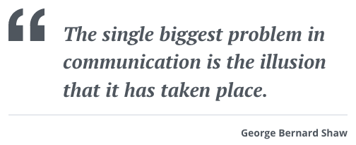
Standard 2:Communicating Effectively

Slide 25
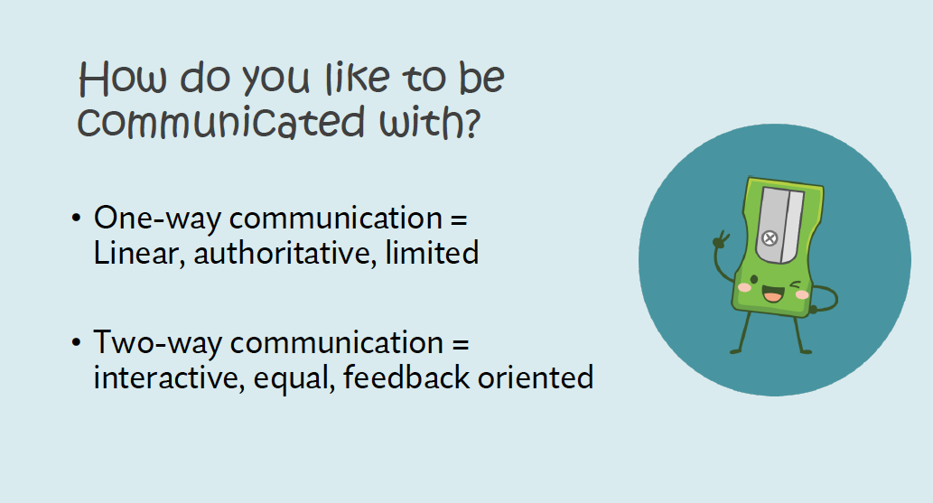

Slide 26
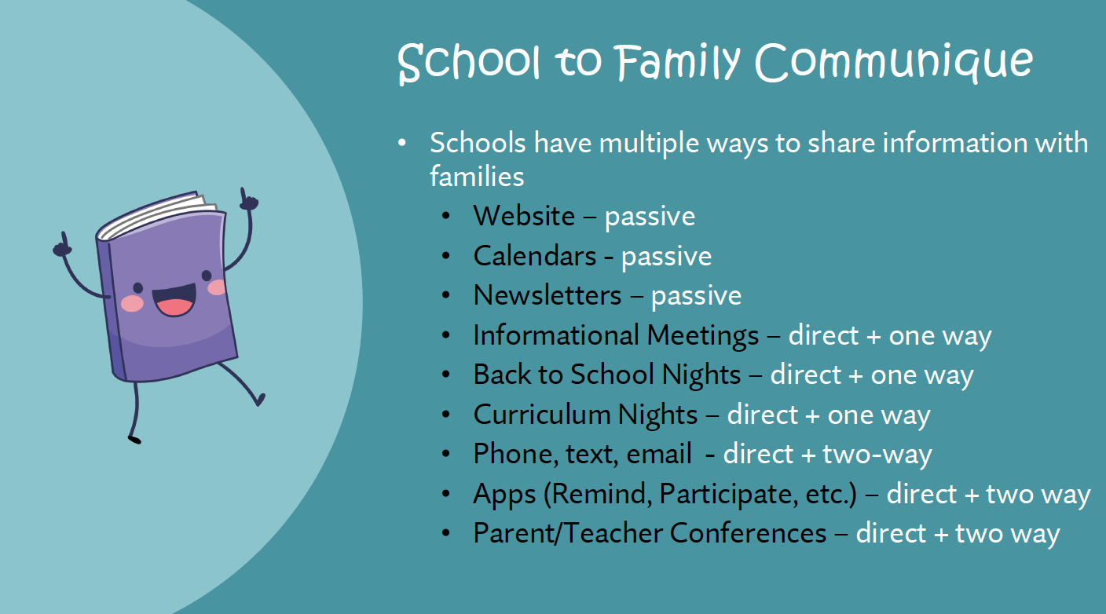
Notes:
Take a look at these and think about Involvement or Engagement. Is there any opportunity for Partnership in these communications?
Communique means: an official announcement or statement, especially one made to the media.

Slide 27
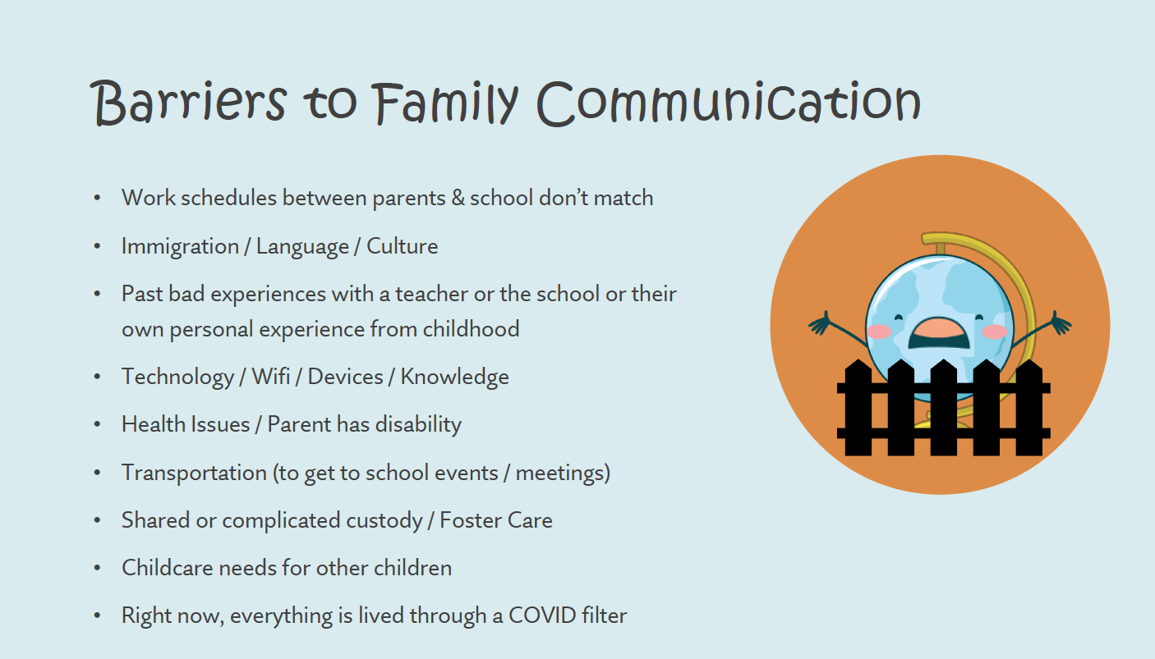
still
^
Notes:
This list is not exhaustive. Can you think of other barriers?

Slide 28
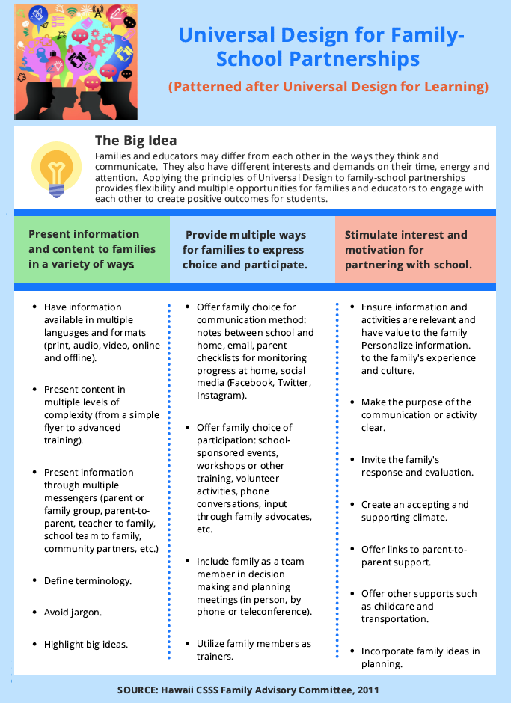
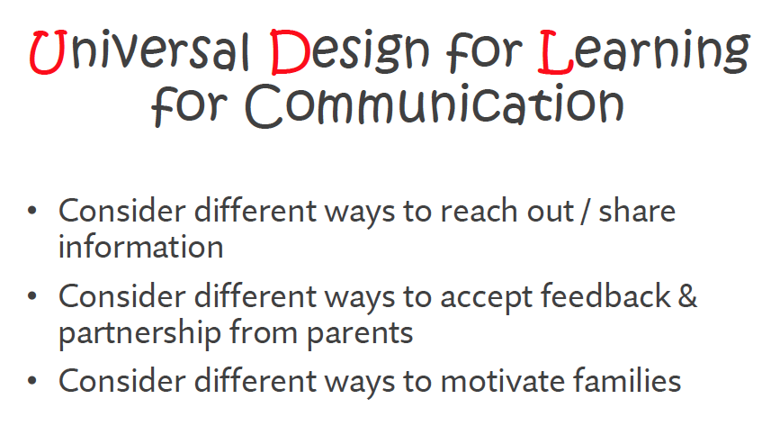
Side note: UDL for Family-School Partnerships was first introduced by the CSSS committee, with parents (including SPIN). SPIN made this infographic based on the word document created by that committee.
Notes:
I hope you are all aware of UDL for learning!
CSSS: Comprehensive Student Support Services : Ivalee, Susan, Martha and other familes
Infographic was created by SPIN a few years ago.

Slide 29
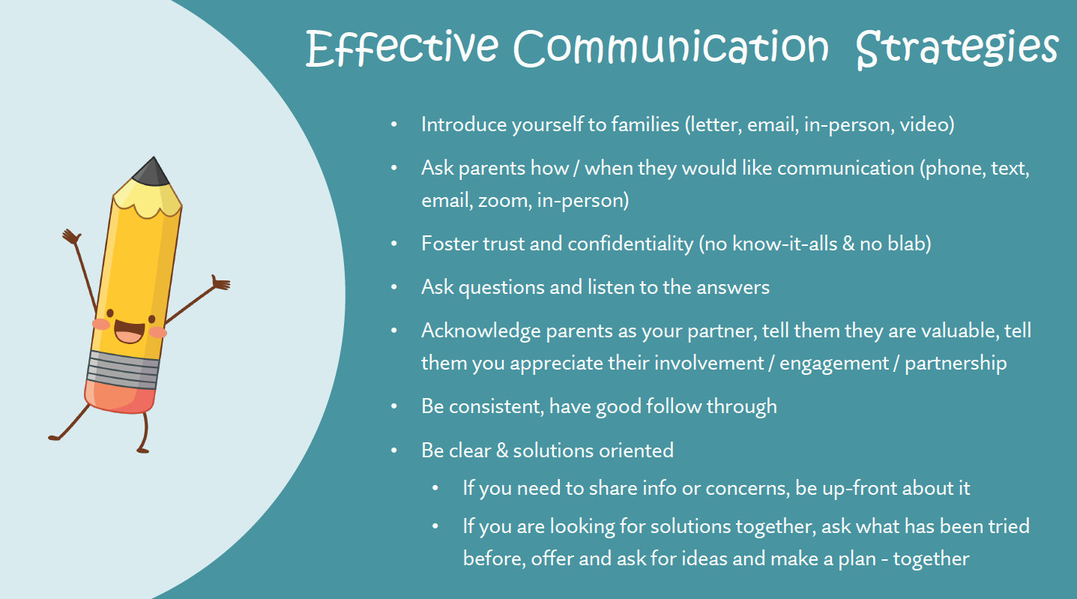

Slide 30
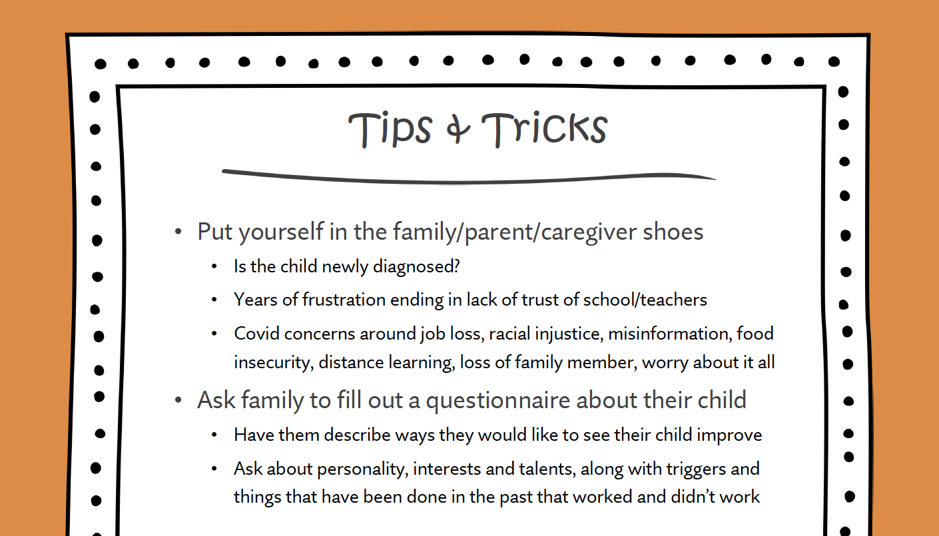
Notes:
Remember – you may have great ideas about how to work with a child, but the parents have been thru several teachers/therapists/doctors and it may have already been tried before. Build spokes on the wheel instead of trying to create a new one.

Slide 31
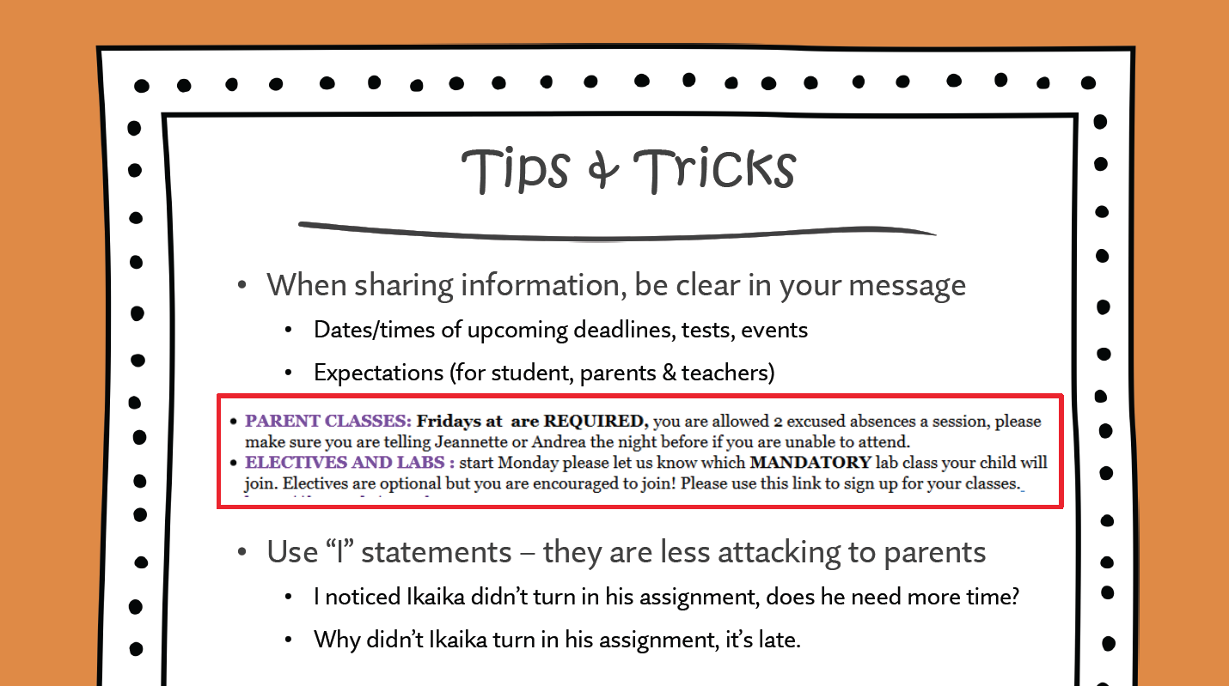
Notes:
There were no times for labs, no info on the classes, no instructor or age info.

Slide 32
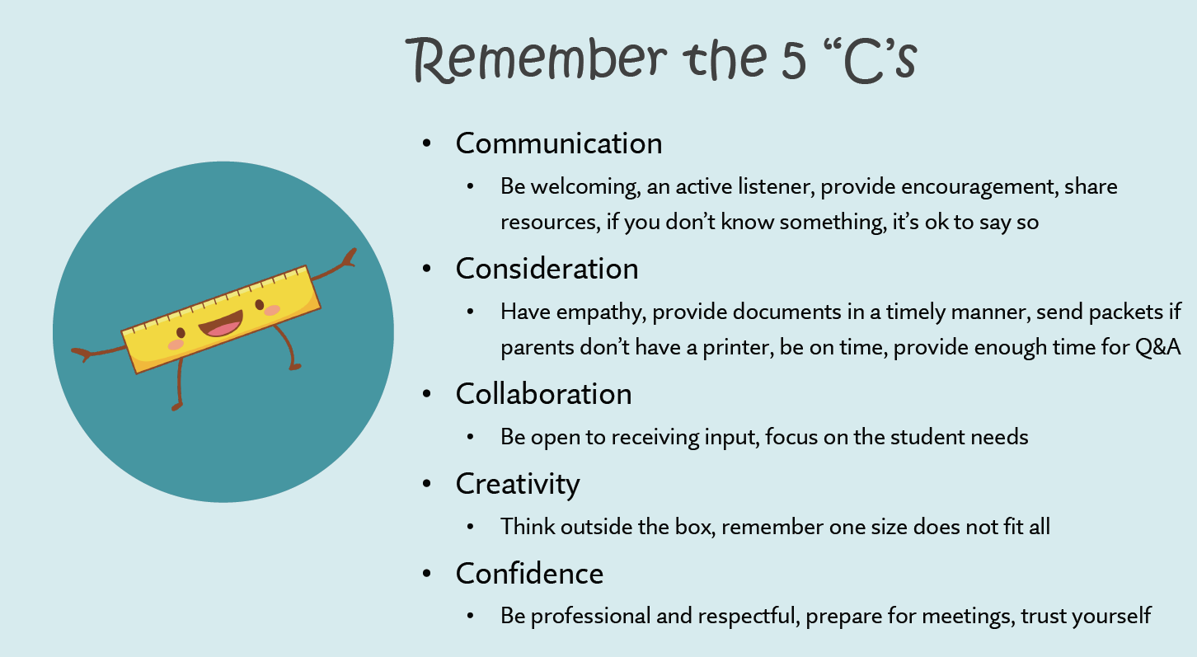
Notes:
both school and parents can admit they don't know something - its really ok!

Slide 33
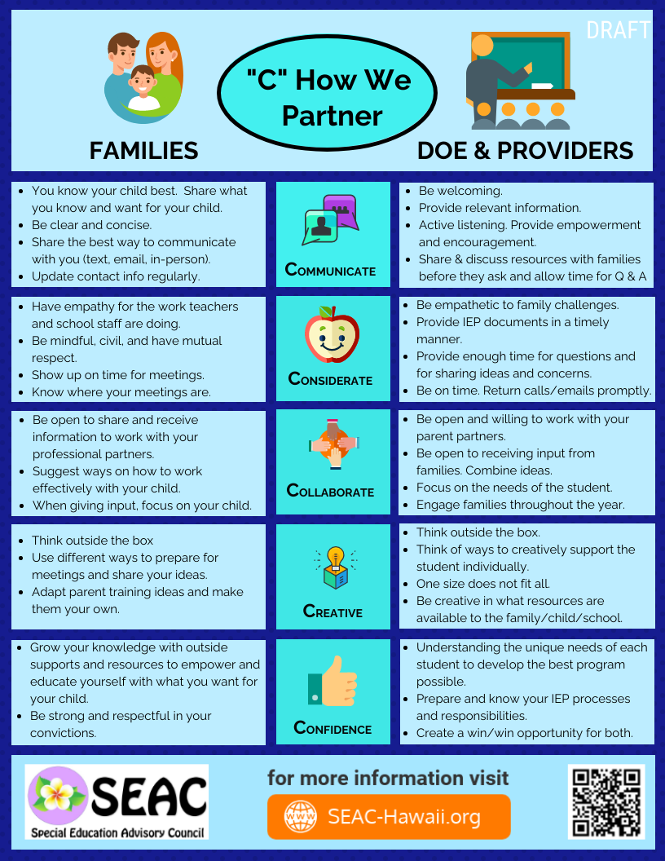
We LOVE Infographics!!
They are great tools to share with staff/parents and students and it puts everyone on the same page.
Created by SEAC
(Special Education Advisory Council)
Notes:
Try sharing an IG like this at the start of your next IEP meeting. See how the dynamic changes when everyone feels like we’re all working together towards the same goals.

Slide 34


Communication Game – Pet Peeve – 5 minutes
In-person & Virtual
Time to blow off some steam and get that empathetic listening ear working, and you can help your co-worker practice active listening at the same time!
In this game, you will pair off.
Player A will start and have a full 60 seconds to rant about something which irks them. It does not have to be work related but should be work appropriate. If you really dislike dealing with traffic, you’ve got great material for your rant.
Player B: listen carefully, try to cut through the noise by singling out:
What Player A really CARES about - like a smoother drive to work or home.
What they VALUE – more time that does not feel wasted.
What MATTERS to them – being with family at the end of the day.
https://positivepsychology.com/communication-exercises-for-work/
Notes:
Write this down: What they CARE about, what they VALUE, what MATTERS to them.

Slide 35
Communication Game – Pet Peeve – 5 minutes
In-person & Virtual
Player B - decode the rant by repeating back to Player A, isolating the key positive points without the fluff or negativity. You can use some variant on the following to help guide your decoding.
You value…
You care about….
You believe that… matters a lot
Then we’ll swap and let the other person rant and decode.
The take-away?
Appreciate that feedback has positive outcomes. Active listening can get to the heart of the issue without hurt feelings. Try to understand the meaning behind the message.
https://positivepsychology.com/communication-exercises-for-work/
Notes:
ask for sharing out
When parents are asking for something that seems too much, look deeper, ask questions of WHY they want it? What do they fear? What do they value and care about? What matters to them? Find a solution together.

Slide 36

Standard 3: Supporting Student Success Through Family Strengthening & Protective Factors

Slide 37

Family Strengthening & Protective Factors
We want families to be strong, independent and supportive…
but it seems we don’t want them too strong, independent and supportive…
Notes:
We want strong, independent, informed parents! They can be our allies and ask for things teachers or admin sometimes cannot. Strong families are more engaged and their kids tend to do better.
I AM that mom, but for awhile, I wasn't and it was a teacher who helped strengthen me and reset my expectations for my kid.

Slide 38
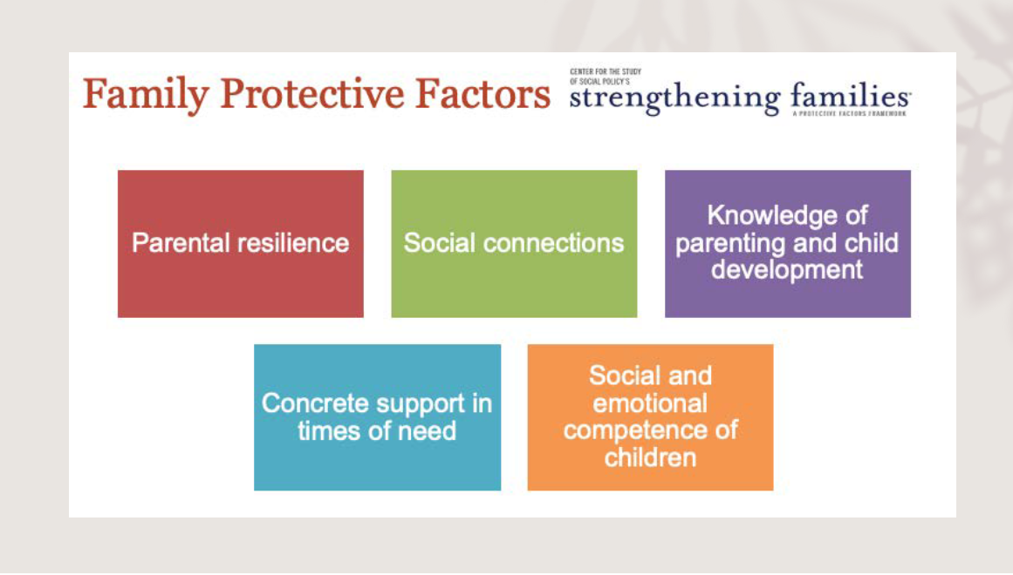
https://cssp.org/our-work/project/strengthening-families/

Slide 39
Parental Resilience
Demonstrate in multiple ways that parents are valued
Honor each family’s race, language, culture, history and approach to parenting
Social Connections
Help families value, build and sustain and use social connections
Create an inclusive environment
Support parents as decision-makers and help build leadership skills
Help parents understand how to support thier child during stressful times
Facilitate mutual support around parenting and other issues
Promote engagement in the community and participation in community activities
Knowledge of Parenting and Child Development
Concrete Supports in Times of Need
Social and Emotional Competence in Children
Model developmentally appropriate interactions with children
Provide information and resources on parenting and child development
Encourage exploration of parenting issues or concerns
Address parenting issues from a strength-based perspective
Respond immediately when families are in crisis
Provide information and connections to other servcies in the community
Help families develop skills and tools they need to identify their needs and connect to supports
Help parents foster their child's social emotional development
Model nurturing supports to children
Iniclude children's social and emotional development activities in programming
Help children develop a positive cultural identity and interact in a diverse society
Food and housing insecurity is still a big issue, help them find the resources they need
https://cssp.org/resource/about-strengthening-families-and-the-protective-factors-framework/
Notes:
Protective factors include a lot of strategies that encourage partnerships. Working together.
Parent Resilience: Help parents understand how to support thier kid during stress
Social Connections: connect families to each other, facilitate mutual support around parenting and other issues
Knowledge: Model developmentally appropriate interactions with children
Concrete supports: respond immediately when families are in crisis
Social/Emotional: Help parents foster their childs emotional development

Slide 40
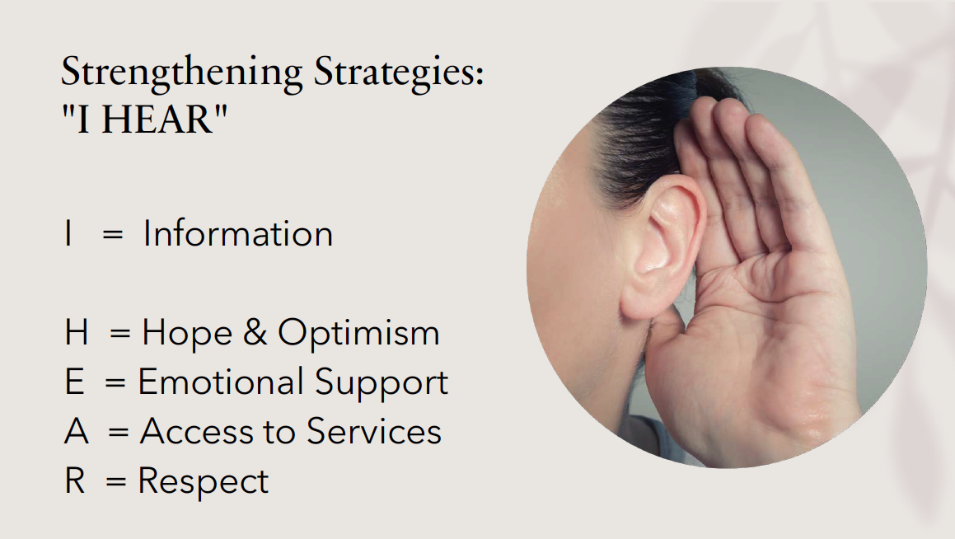

Slide 41
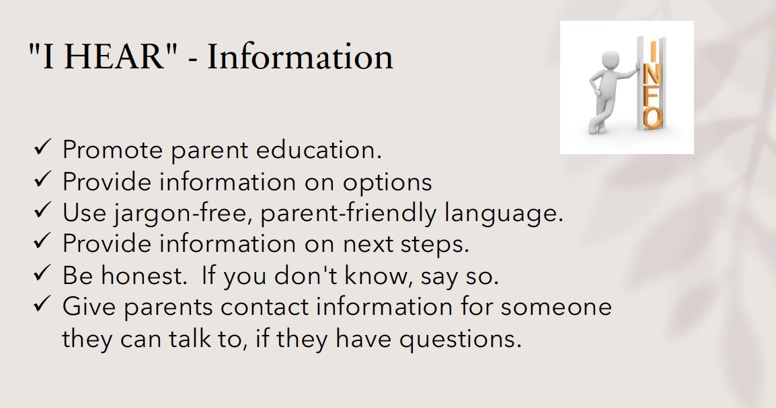
I
I
Notes:
Are we starting to see some repeat messages?

Slide 42
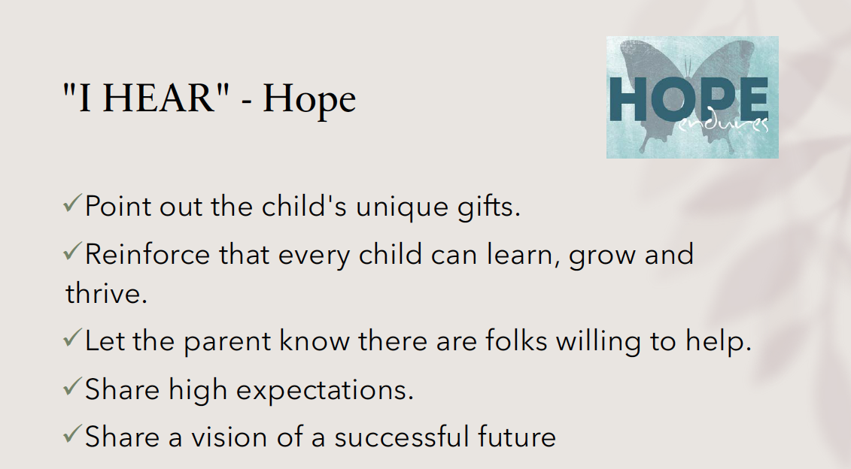
H
H

Slide 43
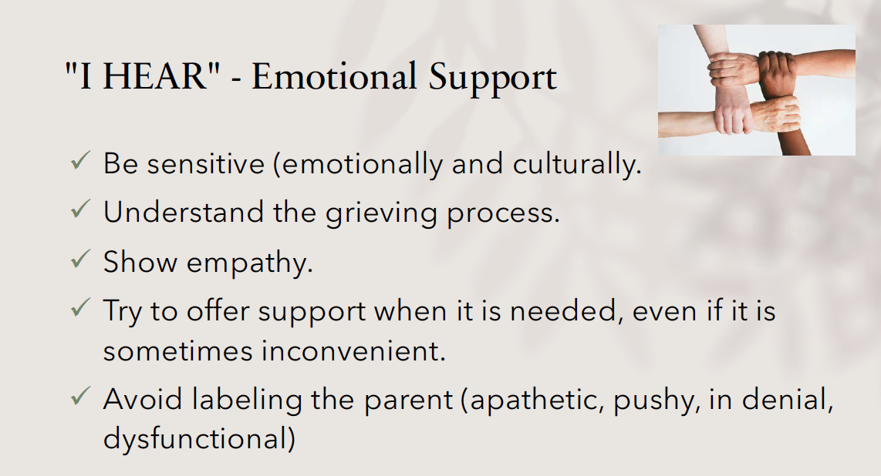
E
E

Slide 44
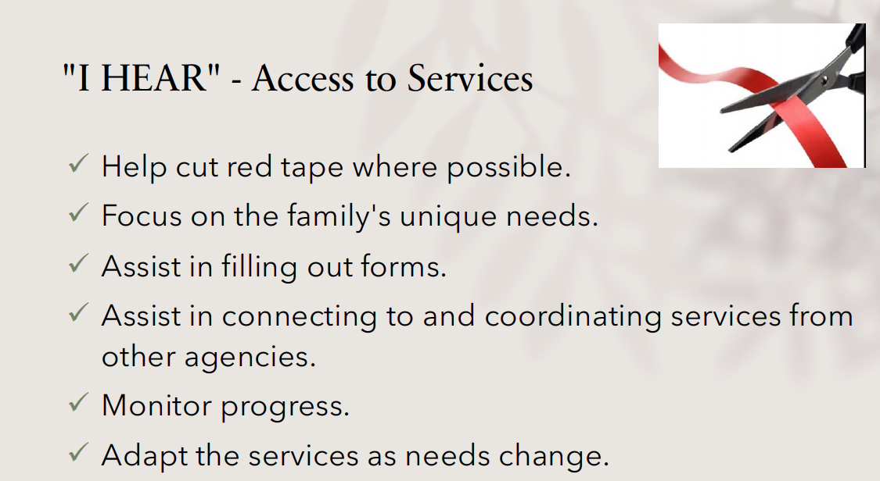
A
A

Slide 45
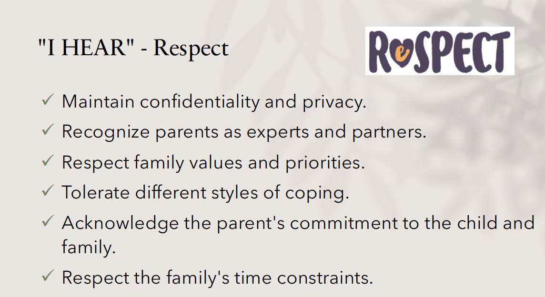
R
R

Slide 46
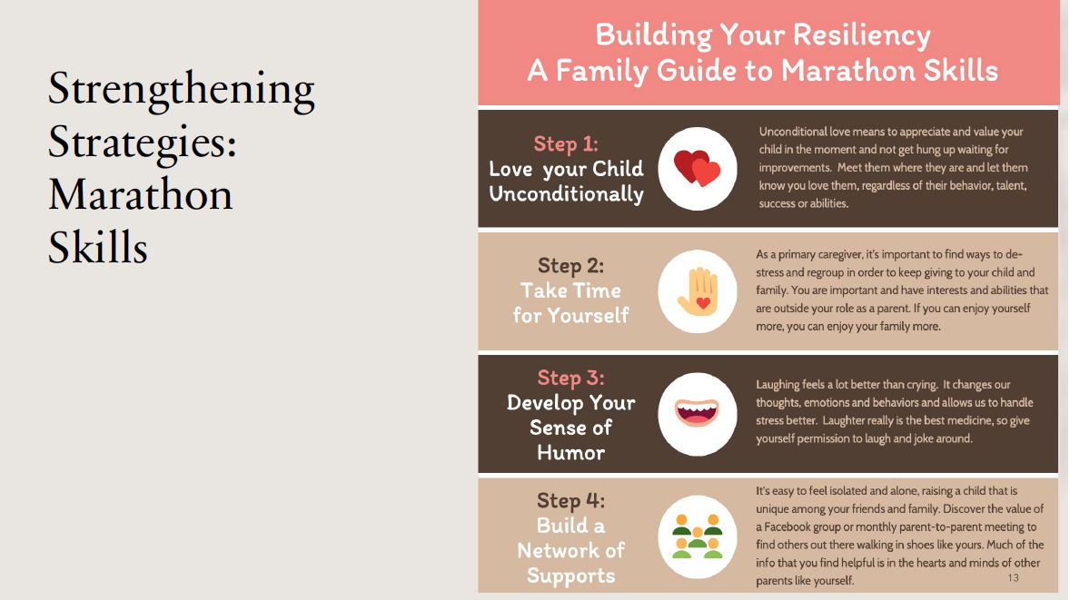
Because raising a child with a disability is a marathon,
not a sprint!

Slide 47


Notes:
shameless plug

Slide 48

Standard 4: Speaking Up for Every Child

Slide 49
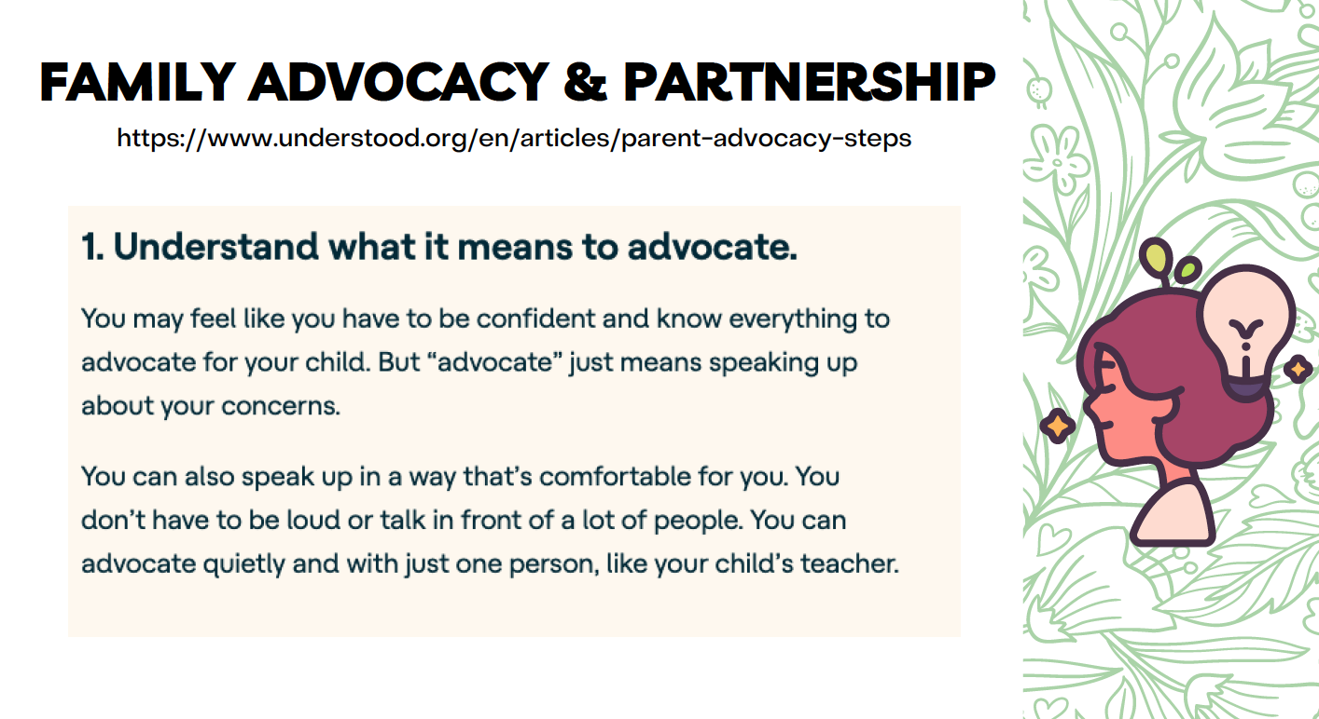
https://www.understood.org/articles/parent-advocacy-steps
Notes:
These slides were made for parents, but they apply to everyone. I’ve had teachers quietly advocate to me and I was able to advocate those concerns in meeting without getting them in ”trouble”.

Slide 50
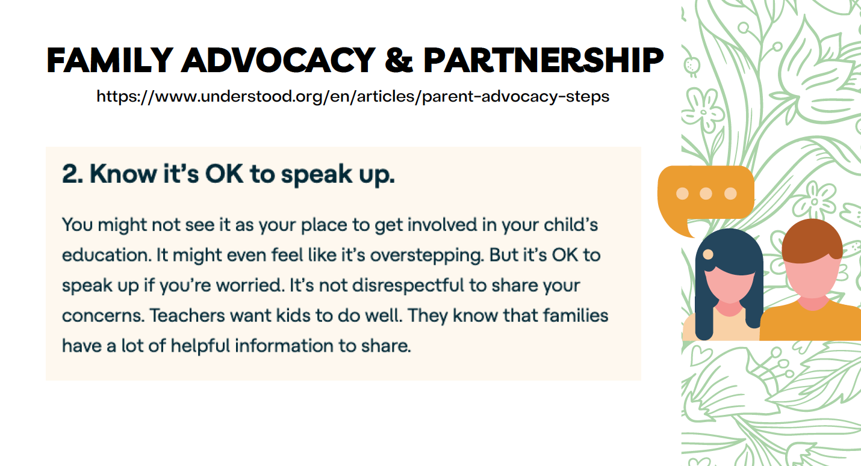
Notes:
And teachers/admin, please listen to those concerns. They wouldn’t share if it wasn’t important. Remember the Venting Activity? Why are the parents speaking up? Whats important to them? What do they value? Probably the same things you do.

Slide 51
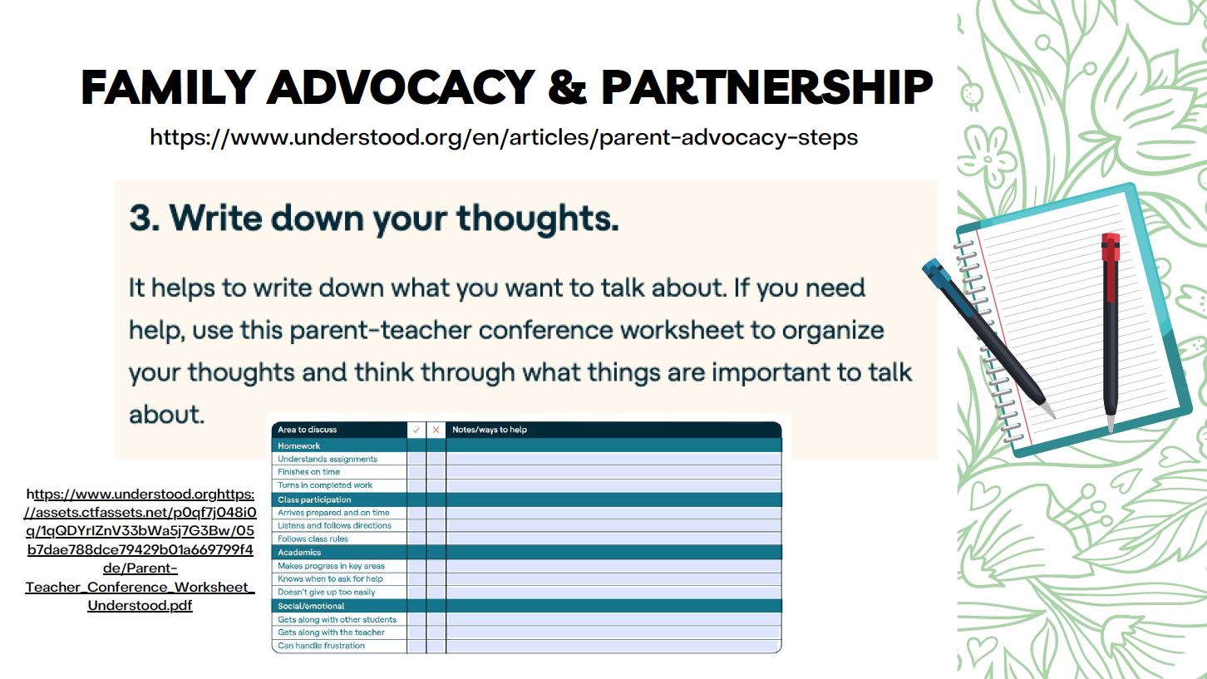
https://www.understood.org/articles/download-parent-teacher-conference-worksheet
Notes:
What if you gave this to a parent and asked them to bring it to the next parent/teacher or IEP meeting. Look at the partnership opportunities!

Slide 52
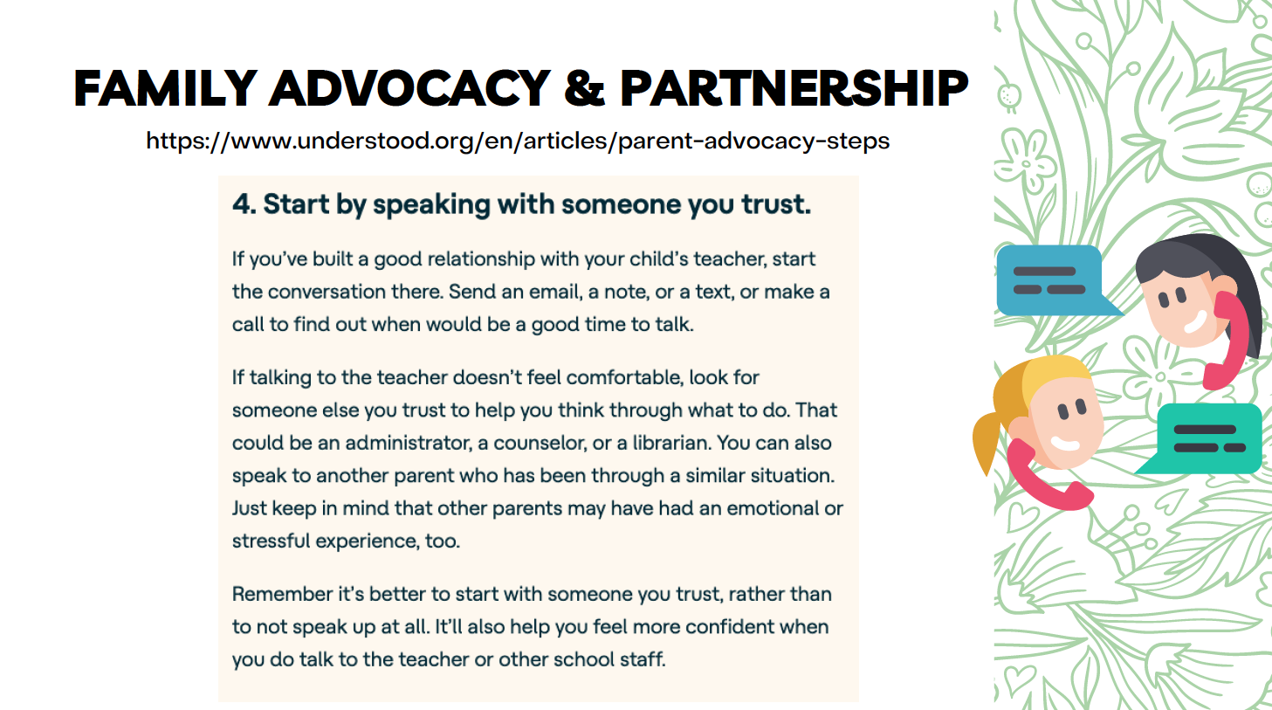
Notes:
For teachers, do you have an ally at school you can talk to?
For admin – who do you turn to to ask questions or see if you’re on the right path?
Does your school trainings offer opportunities to brainstorm solutions? Do your data teams have the chance to talk about family strengthening strategies?
You - each and every one of you - can also call SPIN. We are confidential and support families and professionals!

Slide 53
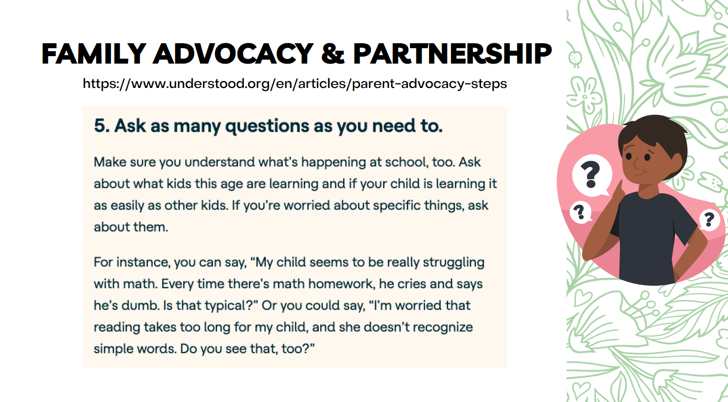
Notes:
Help families understand what is age appropriate behavior, even if its not good behavior. Guide families to resources, or consider a tutoring night to explain the current curriculum and how to help kids achieve positive results. How about a behavior night and bring in a specialist? But be sure to invite ALL parents, not just the ones who you assume ”need” it.

Slide 54
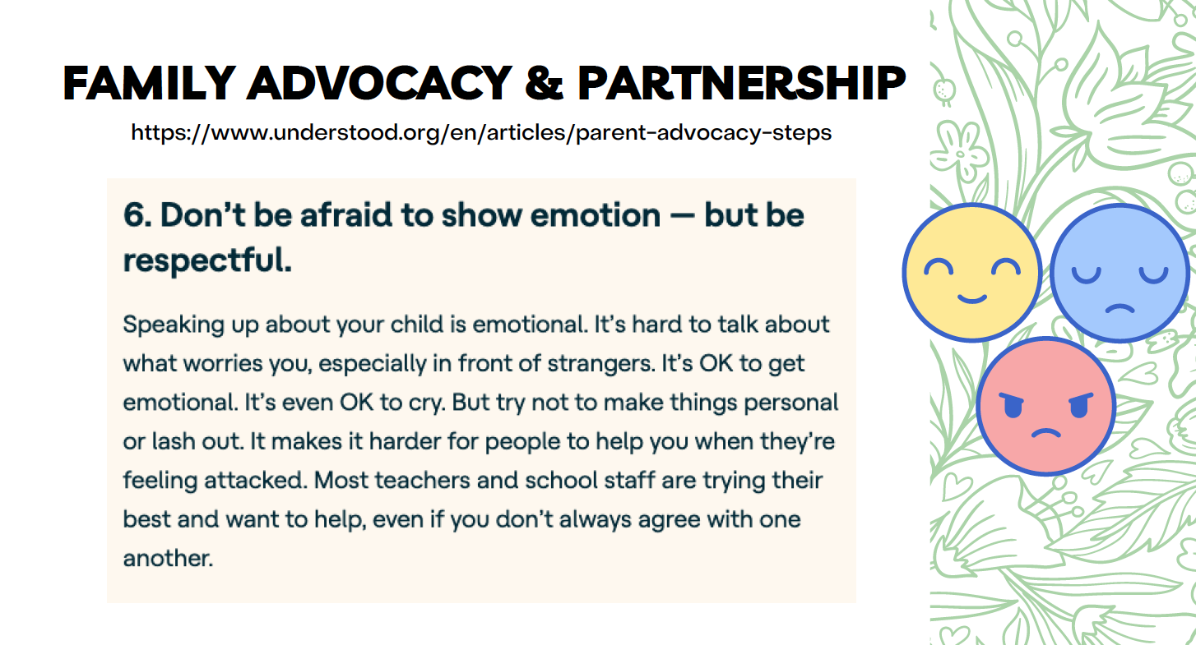
Notes:
For families, this is personal to THEM. It’s not personal TO YOU.
crying is like venting - just a different way.

Slide 55


Can you share a time when parent advocacy was positive and a good thing for the student?
Think about a time when a parent was advocating for something that seemed “too much” or the
request seemed ”unreasonable”.
Think about why that parent was asking for it? What was the root cause? What was their fear?
What mattered to them? What did they value?
Notes:
Candy for those who speak up.

Slide 56
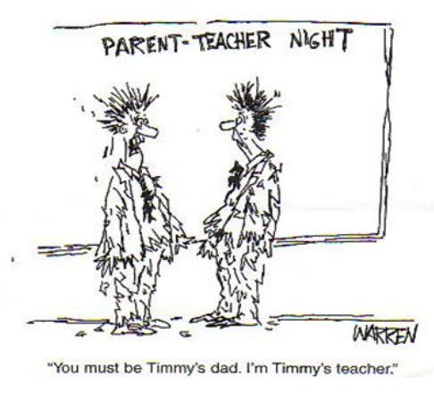
Standard 5: Equal Partners

Slide 57
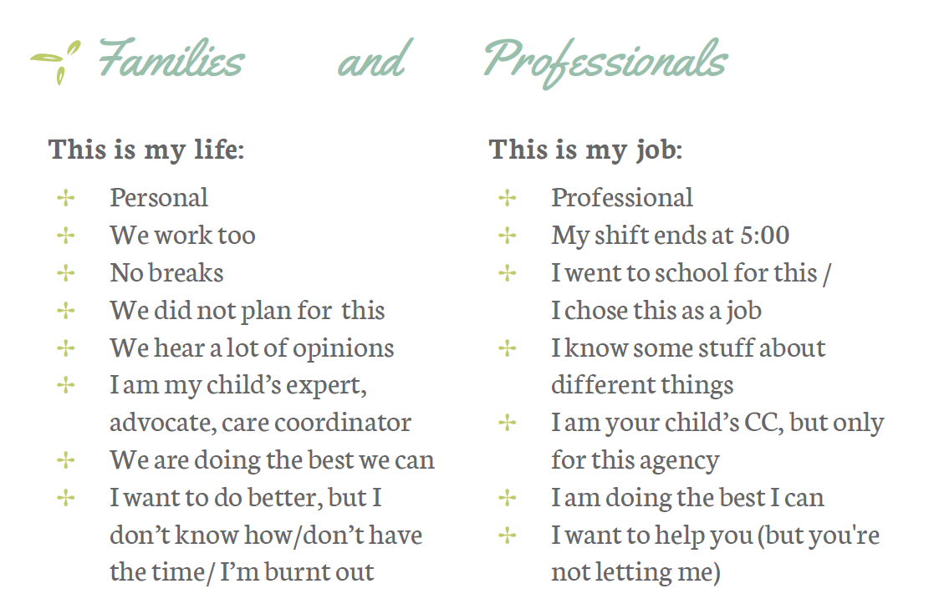
We see the world thru different lenses… and both are correct and equal in value.
Notes:
It’s easy to find partners that share the same commonalities. Same school, same work schedule, same grade… but it’s more difficult to make partner with someone who has a different perspective or lens. But Those partnerships can be the BEST in achieving success!

Slide 58
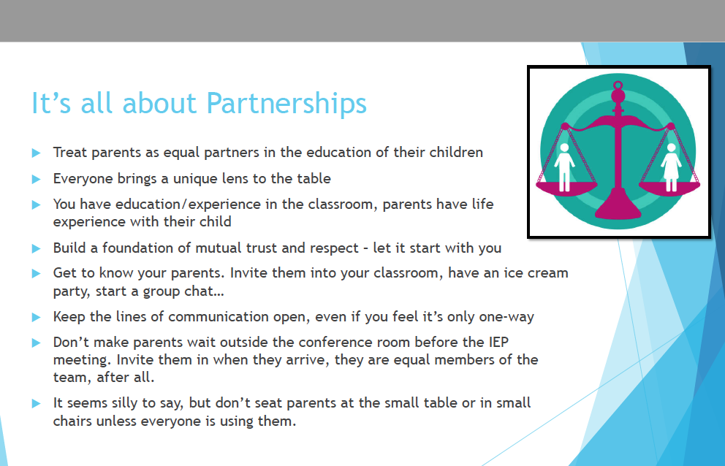
Notes:
Remember that you are the professional in the partnership and it may need to start with you to extend the olive branch.
if we have parents in the room, this means you too!

Slide 59
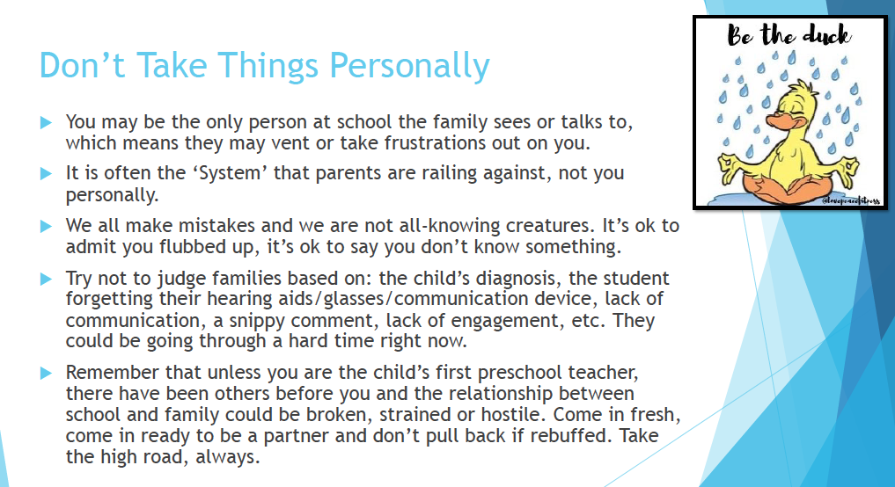
Notes:
Tell the story of the stars/planets at the Zoo
For families, same things, no judging! teachers may have had a difficult parent that has made them very weary of parents. Extend the olive branch and show how parents can be equal and understanding partners.

Slide 60
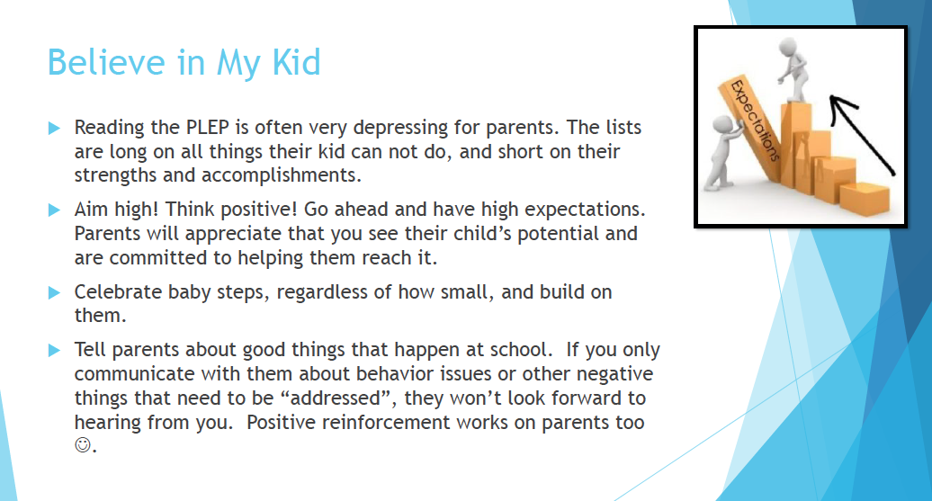
Notes:
tell the story about the math test and Mrs. Pierce

Slide 61
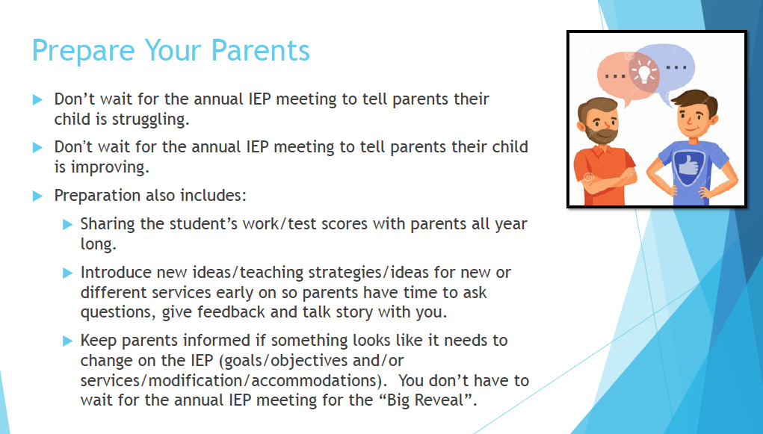
Notes:
consider bi-weekly check ins… or monthly parent meetings to share new ideas – in both directions.

Slide 62
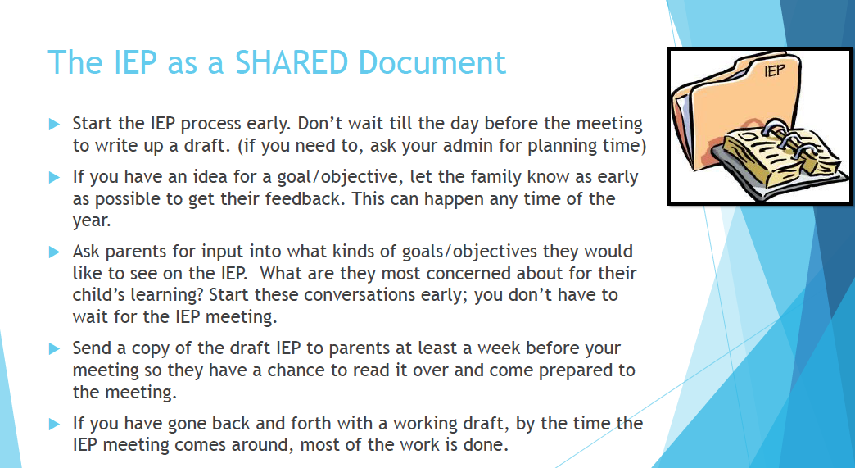
Notes:
ask support staff (OT/PT SLP, ABA, etc.) for their reports and input about a month in advance. Send this info to the parent for review and comments.

Slide 63
Would you like to share some tips that worked for you about Family Engagement / Partnership?
Tell me how you’re going to take this information and run with it!
Who’s coming to the SPIN Conference in April? ☺
What questions do you have? Lets talk story!
SPIN is a resource for parents AND professionals! Call us!

Slide 64


Susan Rocco – susan.rocco@doh.Hawaii.gov
Amanda Kaahanui – amanda.Kaahanui@doh.Hawaii.gov
www.SPINconference.org
www.SPINhawaii.org
808-586-8126

